Slide 1
Hymns for Worship at Woodmont
97s- Servant’s Song
113- Where No One Stands Alone
15s- Exalted
72- Be with Me Lord
307- Are You Washed in the Blood?
Notes:
After Jesus prayed, disciple said, “Lord, teach us to pray.” (Lk 11:1). Don’t have time! Take Time to be Holy. Jesus was effective in his prayers. Often wilderness & pray (away from crowd, demand for sign, miracle, healing, etc. Pharisees plotting to kill him- exposed as hypocrites & refused to repent, demand for a sign, miracle, etc. Prayed all night before choosing apostles & prayed for them often, at His baptism, transfiguration, & Garden before crucifixion. Apostles preached to every creature & prayed & depended on the Lord & were effective in planting & watering the seed. Are we effective? Gospel Meeting with Larry Tomlin.

Slide 2
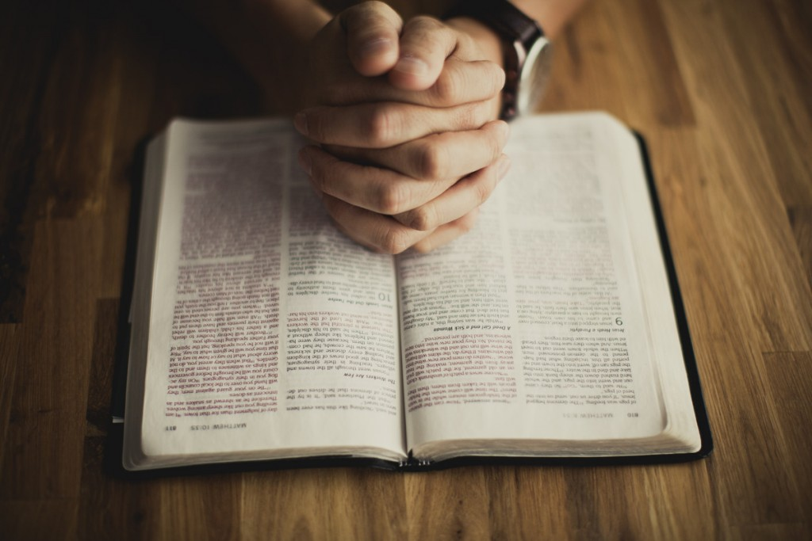
What Effective Prayer Requires
Notes:
After Jesus prayed, disciple said, “Lord, teach us to pray.” (Lk 11:1). Don’t have time! Take Time to be Holy. Jesus was effective in his prayers. Often wilderness & pray (away from crowd, demand for sign, miracle, healing, etc. Pharisees plotting to kill him- exposed as hypocrites & refused to repent, demand for a sign, miracle, etc. Prayed all night before choosing apostles & prayed for them often, at His baptism, transfiguration, & Garden before crucifixion. Apostles preached to every creature & prayed & depended on the Lord & were effective in planting & watering the seed. Are we effective? Gospel Meeting with Larry Tomlin.

Slide 3
What Effective Prayer Requires
Thanksgiving
(Col. 4:2; Phil. 4:6-7; Matt. 7:11; 1 Tim. 1:12ff)
Notes:
Be devoted in prayer, keeping alert with thanksgiving, Be thankful everyday, God created this world & gave you life (forget it- apostacy),, live with freedom to worship, preach word w/o fear of the government arresting us, have to worry but in everything pray with thanksgiving & you’ll have God’s peace. Children often take for granted what their parents give them (Mt. 7:11). Count your blessings, especially the gift of salvation which none of us deserves. The apostle Paul- I thank Christ Jesus our Lord, who has strengthened me, because He considered me faithful, putting me into service,¹³ even though I was formerly a blasphemer and a persecutor and a violent aggressor. Yet I was shown mercy because I acted ignorantly in unbelief; ¹⁴ and the grace of our Lord was more than abundant, with the faith and love which are found in Christ Jesus.¹⁵ It is a trustworthy statement, deserving full acceptance, that Christ Jesus came into the world to save sinners, among whom I am foremost of all. ¹⁶ Yet for this reason I found mercy, so that in me as the foremost, Jesus Christ might demonstrate His perfect patience as an example for those ^{[l]}who would believe in Him for eternal life.

Slide 4
What Effective Prayer Requires
Thanksgiving
(Col. 4:2; Phil. 4:6-7; Matt. 7:11; 1 Tim. 1:12ff)
Humility
(Luke 22:42; 18:9-14; 2 Kings 22:19; Phil. 2:3ff)
Notes:
Jesus prayed, not My will-Yours be done. Humble, dependent, His Father’s will. Pharisees trusted they were righteous & viewed others were contempt. Thanked God not like sinners & boasted about their good deeds. Tax collector- God be merciful to me a sinner. Who was justified? Those who exalt themselves humbled, those who humble themselves exalted. King Josiah ordered temple repaired, the high priest finds God’s book & Josiah humbled himself- “because your heart was tender & you humbled yourself before the Lord when you heard what I spoke against this place & against its inhabitants that they should become a desolation & a curse, & you have torn your clothes and wept before Me, I truly have heard you,” declares the Lord. He would have peace (died in 609 before Babylonian captivity). Humble yourself like Jesus did- obedience.

Slide 5
What Effective Prayer Requires
Thanksgiving
(Col. 4:2; Phil. 4:6-7; Matt. 7:11; 1 Tim. 1:12ff)
Humility
(Luke 22:42; 18:9-14; 2 Kings 22:19; Phil. 2:3ff)
Obedience
(Jer. 29:10ff; Dan. 9:2ff; John 14:14-15; 1 Pet. 3:12)
Notes:
Jeremiah- 70 year captivity. “Then you will call upon Me and come and pray to Me, and I will listen to you. ¹³ You will seek Me and find Me when you search for Me with all your heart. (Jer. 29:13). About 70 years later Daniel is reading God’s word & prays as recorded in Dan. 9:2ff. I, Daniel, observed in the books the number of the years which was revealed as the word of the Lord to Jeremiah the prophet for the completion of the desolations of Jerusalem, namely, seventy years. ³ So I ^{[a]}gave my attention to the Lord God to seek Him by prayer and supplications, with fasting, sackcloth and ashes. Jesus said, “If you ask Me anything in My name I wll do it. If you love Me, keep My commands! The Lord hears the prayers of the righteous!

Slide 6
What Effective Prayer Requires
Confidence
(Jas. 1:5ff; He. 4:16; Lk. 22:32; Ax 4:13,29; 1 Jn. 5:14)
Notes:
You say I obey but suffering through trials (cancer, disease, pain, heavy burdens), don’t know if God hears- test. Joy opportunity to grow spiritually-used in His service. Pray with confidence (faith) Doubts like surf of the sea drivien & tossed by the wind, let not that man expect that he will receive anything from the Lord being a double minded man unstable in all his ways. God promises to give generously & w/o reproach. Jesus died for you, sympathizes with you in your suffering. Go boldly to God’s throne of grace. Peter denied the Lord 3X went & wept bitterly after the Lord looked at him. Changed, convicted, preached, imprisoned, Sandhedrin saw his confidence- been with Jesus- Praying for boldness.

Slide 7
What Effective Prayer Requires
Confidence
(Jas. 1:5ff; He. 4:16; Lk. 22:32; Ax 4:13,29; 1 Jn. 5:14)
Persistence
(1 Th. 5:17; Luke 18:1ff; 11:8; Jas. 5:16ff; Col. 4:12)
Notes:
Don’t give up or lose heart but many have. Pray w/o ceasing. Widow who pleaded with an unjust judge. He finally gave in to her request, worn down by her determination. How much more will God, the righteous Judge, listen to the persistent prayers of His loved ones who cry out to Him day & night. Friend at midnight- I need food! Give him what he needs because of his persistence! Persistent prayer for healing, loved ones to be restored! Gospel to spread. GM.

Slide 8
What Effective Prayer Requires
Confidence
(Jas. 1:5ff; He. 4:16; Lk. 22:32; Ax 4:13,29; 1 Jn. 5:14)
Persistence
(1 Th. 5:17; Luke 18:1ff; 11:8; Jas. 5:16ff; Col. 4:12)
Patience
(Isa. 38:1ff; 2 Cor. 12:7-10; Ps. 27:14; Rom. 8:25)
Notes:
Wait for the Lord; Be strong and let your heart take courage; Yes, wait for the Lord (Ps. 27:14). Patience is a virtue (Job). When is God going to answer my prayer? Hezekiah told he’s going to die. He prays, “Remember O Lord, how I have walked before You in truth, with a whole heart, & have done what is good in Your sight.”Hezekiah wept bitterly. God’s word came to Isaiah, saying, “Go & say to Hezekiah, ‘Thus says the Lord,“I have heard your prayer, I have seen your tears; behold, I will add fifteen years to your life. I will deliver you and this city from the hand of the king of Assyria; and I will defend this city.”’ But it may not be Paul’s thorn in the flesh not removed as God’s grace was sufficient for him, power is perfected in weakness. In hope we have been saved! God will save His faithful servants & bring them to His heavenly kingdom.

Slide 9
Hymns for Worship at Woodmont
97s- Servant’s Song
113- Where No One Stands Alone
15s- Exalted
72- Be with Me Lord
307- Are You Washed in the Blood?

