Slide 1
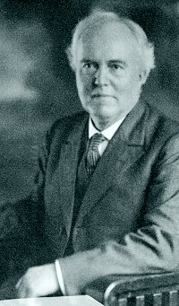
Wonderful Love
of Jesus
by
E. S. Lorenz
1854-1942
First Published 1883

Slide 2
Wonderful Love of Jesus by E. S. Lorenz
In vain in high and holy lays (Ephesians 3:14-21)
My soul her grateful voice would raise; (Hebrews 13:15)
For who can sing the worthy praise (Revelation 5:11-14)
Of the wonderful love of Jesus? (Ephesians 5:2; Matt. 22:37)
Lays are songs & this hymn declares them as vain since no
one can adequately praise His love completely in song. But
we are seeking to love Him with all our heart, soul, mind &
strength & praise Him with our lips in response to His love the
best that we can.

Slide 3
Wonderful Love of Jesus by E. S. Lorenz
A joy by day, a peace by night, (Ps. 90:14; Pr. 3:24; Gal. 5:22)
In storms a calm, in darkness light; (Mark 4:39; John 8:12)
In pain a balm, in weakness might, (Mark 2:17; 1 Peter 2:24)
Is the wonderful love of Jesus. (John 15:13; 2 Cor. 12:9)
Because of Jesus’ wonderful love we have peace & joy every
day; His light guides us through the dark storms to the state
of serenity; & we receive medicine from the Great Physician to
give us strength to soothe us when we are suffering.

Slide 4
Wonderful Love of Jesus by E. S. Lorenz
My hope for pardon when I call, (Acts 22:16; 1 Peter 3:21)
My trust for lifting when I fall; (Mt 14:31; Lk. 22:32; 1 Jn. 1:9)
In life, in death, my all in all, (Phil. 1:20; 3:7ff)
Is the wonderful love of Jesus. (Rom. 8:35ff)
There is hope for pardon when we call which we do when we
obey the gospel by being baptized into Christ. When we fall
into sin, He lifts us up to fellowship with Him again when we
confess and repent of our sins. As Christians, we know that
the love of Christ will sustain us unto eternal life.

Slide 5
Wonderful Love of Jesus by E. S. Lorenz
Refrain
Wonderful love! Wonderful love!
Wonderful love of Jesus!
Wonderful love! Wonderful love!
Wonderful love of Jesus!
The wonderful love of Jesus as seen throughout His whole life while suffering great persecution & agony on the cross for our sins should lead us to joyfully respond in obedience to His word and serve Him faithfully everyday of our lives until death.

