Slide 1
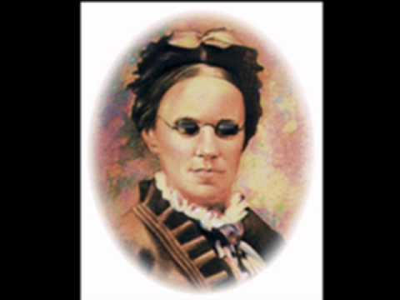
Redeemed
By
Fanny J. Crosby
1882
1820-1915
Melody
By
Wm. J. Kirkpatrick
Notes:
6 weeks old, eye infection. Treatment hot poultices on her eyelids left scars on her eyes blinded for life. She was, however, still able to detect light, thus could distinguish between day and night. When she was only a year old a second major trauma befell her with the death of her father, which left her mother a widow at the age of only 21. Forced to care for four small children, three daughters and a son, Marcy Crosby hired herself out as a maid. Thus, the children were largely looked after by the grandmother, Eunice Crosby. Wrote about 8,000 hymns. Famous.
Fanny developed a very close relationship with her grandmother. The two were inseparable, with the latter becoming the "eyes to the world" for the former. They would spend hours in the meadow together, with Eunice vividly describing the beauty of God's creation all around them. She also read the Bible to Fanny, and explained to her the value of prayer and a relationship with God. It was soon discovered that the little girl had a phenomenal memory and retained almost everything read to her. At the age of ten she had committed to memory, and could repeat without error, the entire Pentateuch, all four Gospels, many of the Psalms, all of Proverbs, and the entire books of Ruth and Song of Solomon. At the close of her life she stated, "The Holy Book has nurtured my entire life."
The word redeemed implies the idea of a slave standing on the trader's auction block being offered to the highest bidder. At last the price is paid by a compassionate new owner, who then gives the slave his unconditional freedom. But the freed slave, out of gratitude to his new owner, offers himself as a loving bond servant for life to his redeemer.

Slide 2
Redeemed by Fanny J. Crosby 1882
Redeemed, how I love to proclaim it! (1 Tim. 1:12-16)
Redeemed by the blood of the Lamb; (Jn. 1:29; 1 Pt. 1:19)
Redeemed through His infinite mercy, (Eph. 2:4ff)
His child and forever I am. (Isa. 54:5-8)
Jesus is the Lamb of God who takes away the sin of the
world. The apostle Paul loved to proclaim it as He had
been forgiven of the most vile sins as an example for
all those who would believe in Him for eternal life!

Slide 3
Redeemed by Fanny J. Crosby 1882
Redeemed, and so happy in Jesus, (Eph. 1:7)
No language my rapture can tell; (Isa. 52:7-10)
I know that the light of His presence (1 John 1:5, 7; 2:3ff)
With me doth continually dwell. (John 8:12)
We who are redeemed through His blood are so happy that
we can have fellowship with the Lord by walking in the
light and know that He is with us all the time!

Slide 4
Redeemed by Fanny J. Crosby 1882
I think of my blessed Redeemer,
I think of Him all the day long: (Phil. 4:8)
I sing, for I cannot be silent;
His love is the theme of my song. (Col. 3:16; Eph. 5:19)
We sing with great joy to the Lord and allow His words to
richly dwell within us.

Slide 5
Redeemed by Fanny J. Crosby 1882
I know I shall see in His beauty (Ps. 45:1, 11)
The King in whose law I delight; (Ps. 119:77, 90, 174)
Who lovingly guardeth my footsteps, (Ps. 17:5; Jude 24-25)
And giveth me songs in the night. (Ps. 42:8)
We delight in the Law of our King who promises to guard
our footsteps from sin and able to keep us from stumbling
so that we can stand in His presence with great joy!

Slide 6
Redeemed by Fanny J. Crosby 1882
I know there’s a crown that is waiting (Js. 1:12; Rev. 2:10)
In yonder bright mansion for me, (John 14:1-3)
And soon, with the spirits made perfect, (Heb. 12:22-24)
At home with the Lord I shall be. (2 Cor. 5:1, 8)
The spirits of the righteous will be made perfect in that
bright mansion of heaven which the Lord has promised to
those who persevere through trials doing His will!

