Slide 1
Hymns for Worship at Woodmont
106s- Look Down, O God
108s- Christ is Risen
85s- Communion Prayer
60s- Heavenly Love
317- All Things are Ready
66- God Bless You, Go with God
Notes:
Summertime- danger of complacency. Out of school, very few responsibilities, sleep late, vacations, eat too much, temptations abound to sin which can lead you on the path to destruction if you aren’t careful. Complacency- a feeling of quiet pleasure or security, often while unaware of some potential danger, defect, or the like; self-satisfaction or smug satisfaction with an existing situation, condition, Destroy your marriage, your family, your job, nations. Don’t be alarmed the complacent say, Take it easy, go with the flow, got it made in the shade, satisfied with the status quo

Slide 2
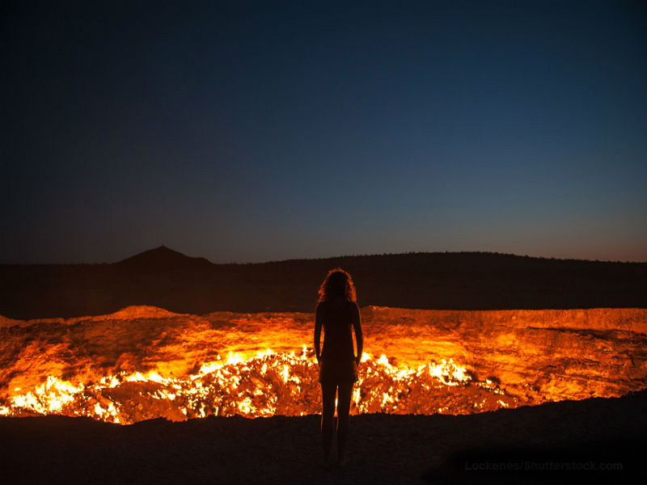
Complacency
Kills
Notes:
Summertime- danger of complacency. Out of school, very few responsibilities, sleep late, vacations, eat too much, temptations abound to sin which can lead you on the path to destruction if you aren’t careful. Complacency- a feeling of quiet pleasure or security, often while unaware of some potential danger, defect, or the like; self-satisfaction or smug satisfaction with an existing situation, condition, Destroy your marriage, your family, your job, nations. Don’t be alarmed the complacent say, Take it easy, go with the flow, got it made in the shade, satisfied with the status quo

Slide 3
“For the waywardness of the naive will kill them, And the complacency of fools will destroy them (Proverbs 1:32).
Notes:
Complacency eventually leads to destruction. Even religious people who are calling Jesus Lord are deceived into thinking that they are going to heaven when Jesus told them depart from Me because they practiced iniquity.

Slide 4
Complacency Kills
Knowledge of God is Insignificant

Slide 5
“The fear of the Lord is the beginning of knowledge; Fools despise wisdom and instruction” (Proverbs 1:7).
“Though by this time you ought to be teachers, you have need again for someone to teach you the elementary principles of the oracles of God, & you have come to need milk and not solid food” (Hebrews 5:12).
“Become sober-minded as you ought, and stop sinning; for some have no knowledge of God. I speak this to your shame” (1 Corinthians 15:34).
Notes:
People haven’t changed since Solomon wrote this by inspiration. Many people don’t fear God and think that His knowledge is insignificant or worthless in living in the 21st century. Clear many in the church don’t fear God either even though they may have been Christians a long time. If you get complacent, If you don’t desire God’s word you will have to be taught again. You practice sin instead of righteousness.

Slide 6
Complacency Kills
Knowledge of God is Insignificant
Ignore Warnings

Slide 7
“Because I called and you refused, I stretched out my hand and no one paid attention; And you neglected all my counsel and did not want my reproof” (Proverbs 1:24-25).
“…we must pay much closer attention to what we have heard, so that we do not drift away from it. For if the word spoken through angels proved unalterable, and every transgression and disobedience received a just penalty, how will we escape if we neglect so great a salvation”? (Hebrews 2:1-3a)
Take care, brethren, that there not be in any one of you an
evil, unbelieving heart that falls away from the living God.
(Hebrews 3:12)
Notes:
Warnings in our life can make difference between life and death. Alerts or Sirens tornado, ambulance, police officers, first responders, etc. How much more spiritually? We can’t be complacenet and refuse to heed warnings from Scripture. Wisdom is personified in Proverbs calling everyday but no one is paying attention. If we don’t pay attention we drift away from God’s word. If they were punished under the OT, how will be escape. Believers can become unbelievers.

Slide 8
If we go on sinning willfully after receiving the knowledge of the truth, there no longer remains a sacrifice for sins, but a terrifying expectation of judgment & the fury of fire which will consume the adversaries. Anyone who has set aside the Law of Moses dies w/o mercy on the testimony of two or three witnesses. How much severer punishment do you think he will deserve who has trampled under foot the Son of God, & has regarded as unclean the blood of the covenant by which he was sanctified, & has insulted the Spirit of grace? For we know Him who said, “Vengeance is mine, I will repay.” And again, “the Lord will judge His people.” It is a terrifying thing to fall into the hands of the living God. (Hebrews 10:26-31)
Notes:
The complacent refuses to heed the warning. Refuse hurricane or tornado warnings because they have hid in their safe place and nothing happened and died. Before you get to that point before you don’t care, you better pay attention because this could be you who dies w/o mercy in the Judgment because you ignore warnings.

Slide 9
“To the angel of the church in Laodicea write:
The Amen, the faithful and true Witness, the Beginning of the creation of God, says this:
‘I know your deeds, that you are neither cold nor hot; I wish that you were cold or hot. So because you are lukewarm, & neither hot nor cold, I will spit you out of My mouth. Because you say, “I am rich, and have become wealthy, and have need of nothing,” and you do not know that you are wretched and miserable and poor and blind and naked…” (Revelation 3:14-17).
Notes:
Laodicean church was lukewarm, they were complacent, satisfied with themselves, boastful attitude and thought they were doing well spiritually, got it made in the shade with our ticket punched to heaven but the Lord exposed the truth about them.

Slide 10
Complacency Kills
Knowledge of God is Insignificant
Ignore Warnings
Lazy/Procrastinate

Slide 11
How long will you lie down, O sluggard?
When will you arise from your sleep?
“A little sleep, a little slumber,
A little folding of the hands to rest”—
Your poverty will come in like a vagabond
And your need like an armed man (Proverbs 6:9-11).
“The desire of the sluggard puts him to death,
For his hands refuse to work” (Proverbs 21:25).
Notes:
If God’s knowledge is insignicant, and you’re ignoring warnings, shouldn’t be surprised if you become sluggish and lazy. Refuse to work, looking for a handout, someone to take care of me.

Slide 12
I will say to my soul, “Soul, you have many goods laid up for many years to come; take your ease, eat, drink and be merry.”’ But God said to him, ‘You fool! This very night your soul is required of you; and now who will own what you have prepared?’ (Luke 12:19-20)
Felix…’sent for Paul and heard him speak about faith in Christ Jesus. But as he was discussing righteousness, self-control & the judgment to come, Felix became frightened’ and said, “Go away for the present, and when I find time I will summon you.”’ (Acts 24:24-25)
Notes:
I’ll get to it tomorrow, take it easy, this person is selfish and thinks he has it made in the shade, living in the lap of luxury. While he is planning for his future, God said his time was up today! Could that be you or me? We know we should respond to the invitation of salvation, but I’ve got plenty of time & I’ll do it someday.

Slide 13
Complacency Kills
Knowledge of God is Insignificant
Ignore Warnings
Lazy/Procrastinate
Lustful/Tolerate Sin
Notes:
An idle mind is the devil’s workshop. When you are complacent about Christianity, it is easy for your mind to be tempted by fleshly desires and tolerate sin.

Slide 14
The adulterous women seduces the young man,
“With her many persuasions she entices him; With her flattering lips she seduces him. Suddenly he follows her As an ox goes to the slaughter, Or as one in fetters to the discipline of a fool, Until an arrow pierces through his liver; As a bird hastens to the snare, So he does not know that it will cost him his life
(Proverbs 7:22-23)
“Wine is a mocker, strong drink a brawler, And whoever is intoxicated by it is not wise” (Prov. 20:1).
Notes:
If you aren’t careful, the dangers of youthful lusts, can ensnare you. Don’t heed the warnings, the adulterous woman knows how to ensnare the young man who is complacent. He is led by his desires to her bedroom and loses his life. Just one drink, don’t heed the warnings.

Slide 15
King David should have been on the battlefield with his men but he stayed in Jerusalem.
“When evening came David arose from his bed & walked around on the roof of the king’s house, & he saw a woman bathing; & the woman was very beautiful in appearance. So David sent & inquired about the woman. And one said, “Is this not Bathsheba, the daughter of Eliam, the wife of Uriah the Hittite?” David sent messengers and took her, and when she came to him, he lay with her; and when she had purified herself from her uncleanness, she returned to her house. The woman conceived; & she sent & told David, and said, “I am pregnant.”” (2 Samuel 11:2-5)
Notes:
Even David the man after God’s own heart was ensnared. Look where his complacency led him! He wasn’t fulfilling his responsibility and was in the wrong place. When you aren’t fulfilling your responsibility in your job, as a spouse, or as a Christian you are vulnerable to temptations. Once you’re ensnared and especially if you are in a position of power it is hard to make it right. Looking at pornography, just one look at that beautiful gir who is immodestly dressed, movie, TV show, etc.

Slide 16
David sent to Joab, saying,
“Send me Uriah the Hittite.” So Joab sent Uriah to David. When Uriah came to him, David asked concerning the welfare of Joab and the people and the state of the war. Then David said to Uriah, “Go down to your house, and wash your feet.” And Uriah went out of the king’s house, and a present from the king was sent out after him. But Uriah slept at the door of the king’s house with all the servants of his lord, and did not go down to his house. Now when they told David, saying, “Uriah did not go down to his house,” David said to Uriah, “Have you not come from a journey? Why did you not go down to your house?” (2 Samuel 11:6-10)
Notes:
He tried to cover up his sin by having Uriah go down to his own house.

Slide 17
Uriah said to David,
“The ark & Israel & Judah are staying in temporary shelters, & my lord Joab & the servants of my lord are camping in the open field. Shall I then go to my house to eat & drink & lie with my wife? By your life & the life of your soul, I will not do this thing.” Then David said to Uriah, “Stay here today also, and tomorrow I will let you go.” So Uriah remained in Jerusalem that day & the next. Now David called him, & he ate & drank before him, & he made him drunk; & in the evening he went out to lie on his bed with his lord’s servants, but he did not go down to his house” (2 Samuel 11:11-13).
Notes:
Uriah refused because he was a faithful soldier in the Lord’s army and apparently was faithful to his wife. David thought if he could get him drunk he would go down but he didn’t go.

Slide 18
Now in the morning David wrote a letter to Joab and sent it by the hand of Uriah. He had written in the letter, saying, “Place Uriah in the front line of the fiercest battle and withdraw from him, so that he may be struck down and die.” So it was as Joab kept watch on the city, that he put Uriah at the place where he knew there were valiant men. The men of the city went out and fought against Joab, and some of the people among David’s servants fell; and Uriah the Hittite also died” (2 Samuel 11:14-17).
Do you see what complacency can lead you to do? King David committed adultery, covered it up by killing a faithful soldier and husband in the Lord’s army & married her!
Notes:
David totally forgot about God’s commands and was only concerned about himself and the scandal this would be to his kingdom. Like the woman who decides to kill her baby in the womb to cover up sin, writes a letter by Uriah’s hand as a messenger who delivered his own death sentence w/o knowing it to Joab. Premeditated murder. It all started with complacency.

Slide 19
“It is actually reported that there is sexual immorality among you, and such sexual immorality as is not even named among the Gentiles—that a man has his father’s wife! And you are puffed up, and have not rather mourned, that he who has done this deed might be taken away from among you” (1 Corinthians 5:1-2).
There is the danger that when you get comfortable with sinners (even in the church) that you tolerate sin instead of rebuking it & disciplining the unrepentant sinner so that he might be restored and not lose his soul!
Notes:
If you are complacent about sin, eventually you get comfortable with it and tolerate it. Divorce, SI, homosexuality and abortion used to be scandalouse but not anymore. A teenage girl in a congregation gets pregnant and the brethren celebrate it with a baby shower with no repentance. I was shocked by the number of Christians I’ve talked to that told me that they have aborted their child.

Slide 20
Complacency Kills
Knowledge of God is Insignificant
Ignore Warnings
Lazy/Procrastinate
Lustful/Tolerate Sin
Suffer Eternally in Hell

Slide 21
“For the waywardness of the naive will kill them, And the complacency of fools will destroy them (Pr. 1:32).
“Not everyone who says to Me, ‘Lord, Lord,’ will enter the kingdom of heaven, but he who does the will of My Father who is in heaven will enter. Many will say to Me on that day, ‘Lord, Lord, did we not prophesy in Your name, and in Your name cast out demons, and in Your name perform many miracles?’ And then I will declare to them, ‘I never knew you; depart from Me, you who practice lawlessness’” (Matthew 7:21-23).
Notes:
Complacency eventually leads to destruction. Even religious people who are calling Jesus Lord are deceived into thinking that they are going to heaven when Jesus told them depart from Me because they practiced iniquity.

Slide 22
“Do not fear those who kill the body
but are unable to kill the soul;
but rather fear Him who is able to destroy
both soul and body in hell”
(Matthew 10:28)
Complacency will kill you and cause you to lose your soul in hell for all of eternity! Do not delay to obey the Lord who loves you and died for your sins!!!
(2 Cor. 6:2; Acts 2:38; Rom. 5:8)
Notes:
It all starts because people don’t fear what God can do, and thus they ignore the warnings, become lazy, lust in their hearts to fulfill their desires, tolerate sin, and will suffer in hell for all of eternity because they were complacent about God’s will. Don’t let that be you!

Slide 23
Complacency Kills
Knowledge is Insignificant
Ignore Warnings
Lazy/Procrastinate
Lustful/Tolerate Sin
Suffer Eternally in Hell

Slide 24
Hymns for Worship at Woodmont
106s- Look Down, O God
108s- Christ is Risen
85s- Communion Prayer
60s- Heavenly Love
317- All Things are Ready
66- God Bless You, Go with God

