Slide 1
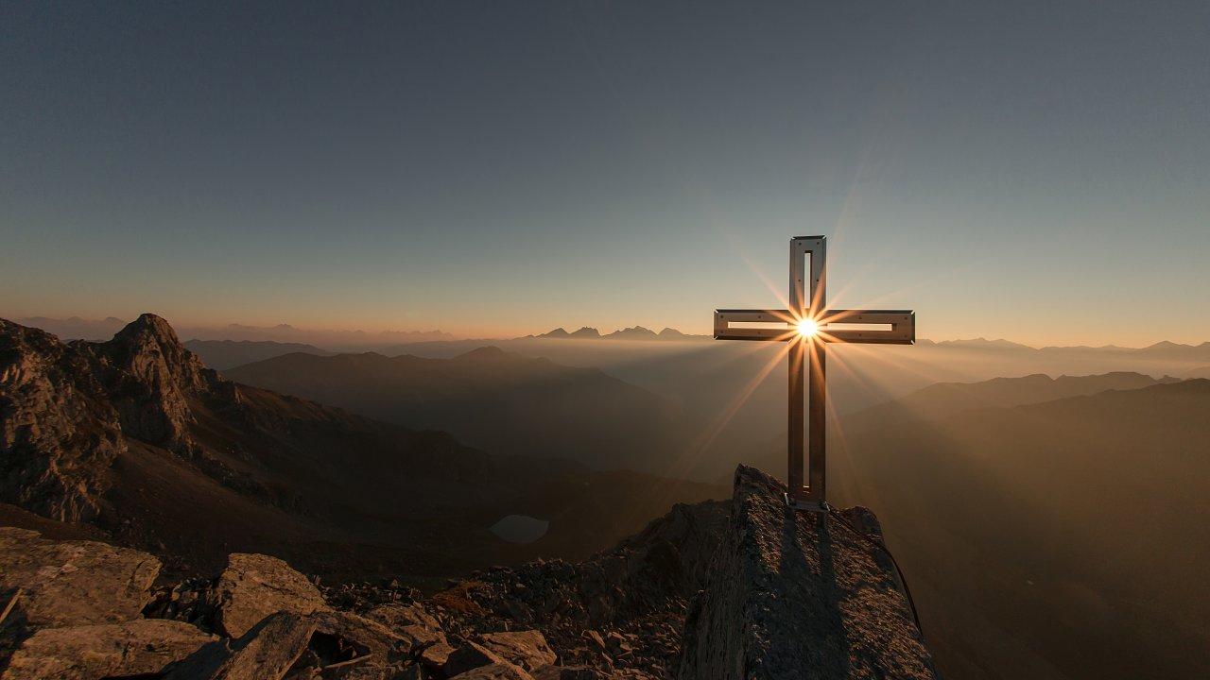
The World Rejoices while Righteous Suffer but it will Turn to Joy (John 16:20)

Slide 2
World Rejoices | Righteous Suffer

Slide 3
World Rejoices | Righteous Suffer
Killing Jesus, threaten His followers (John 16:2; Matt. 27:20-22; Acts 4:18-22)

Slide 4
Jesus said to His disciples,
“They will make you outcasts from the synagogue, but an hour is coming for everyone who kills you to think that he is offering service to God” (John 16:2)
“The chief priests and the elders persuaded the crowds to ask for Barabbas and to put Jesus to death. But the governor said to them, “Which of the two do you want me to release for you?” And they said, “Barabbas.” Pilate *said to them, “Then what shall I do with Jesus who is called Christ?” They all *said, “Crucify Him!” And he said, “Why, what evil has He done?” But they kept shouting all the more, saying, “Crucify Him!” (Matthew 27:20-22).

Slide 5
The Council couldn’t deny the evidence that the apostles healed the lame man and so when they “had summoned them, they commanded them not to speak or teach at all in the name of Jesus. But Peter and John answered and said to them, “Whether it is right in the sight of God to give heed to you rather than to God, you be the judge; for we cannot stop speaking about what we have seen and heard.” When they had threatened them further, they let them go (finding no basis on which to punish them) on account of the people, because they were all glorifying God for what had happened; for the man was more than forty years old on whom this miracle of healing had been performed” (Acts 4:18-22).

Slide 6
World Rejoices | Righteous Suffer
Killing Jesus, threaten His followers (John 16:2; Matt. 27:20-22; Acts 4:18-22) | Persecution (2 Tim. 3:10-13)

Slide 7
The apostle Paul said to Timothy,
“Now you followed my teaching, conduct, purpose, faith, patience, love, perseverance, persecutions, and sufferings, such as happened to me at Antioch, at Iconium and at Lystra; what persecutions I endured, and out of them all the Lord rescued me! Indeed, all who desire to live godly in Christ Jesus will be persecuted. But evil men and impostors will proceed from bad to worse, deceiving and being deceived” (2 Timothy 3:10-13).

Slide 8
World Rejoices | Righteous Suffer
Killing Jesus, threaten His followers (John 16:2; Matt. 27:20-22; Acts 4:18-22) | Persecution (2 Tim. 3:10-13)
Hatred for God’s Word (John 15:18-25)

Slide 9
John 15:18-25,
“If the world hates you, you know that it has hated Me before it hated you.
If you were of the world, the world would love its own; but because you are not of the world, but I chose you out of the world, because of this the world hates you.
Remember the word that I said to you,
‘A slave is not greater than his master.’
If they persecuted Me, they will also persecute you; if they kept My word, they will keep yours also. But all these things they will do to you for My name’s sake, because they do not know the One who sent Me….

Slide 10
…If I had not come and spoken to them, they would not
have sin, but now they have no excuse for their sin.
He who hates Me hates My Father also.
If I had not done among them the works which no one
else did, they would not have sin; but now they have both
seen and hated Me and My Father as well.
But they have done this to fulfill the word that is written in
their Law, ‘They hated Me without a cause.’

Slide 11
World Rejoices | Righteous Suffer
Killing Jesus, threaten His followers (John 16:2; Matt. 27:20-22; Acts 4:18-22) | Persecution (2 Tim. 3:10-13)
Hatred for God’s Word (John 15:18-25) | While loving their enemies (Matt. 5:43-45; Acts 7:59-60)

Slide 12
Jesus said, “You have heard that it was said, ‘You shall
Love your neighbor and hate your enemy.’ But I say to
you, love your enemies and pray for those who persecute
you, so that you may be sons of your Father who is in
heaven” (Matthew 5:43-45a).
Stephen rebuked sinners and in response…
“They went on stoning Stephen as he called on the Lord
and said, “Lord Jesus, receive my spirit!” Then falling on
his knees, he cried out with a loud voice, “Lord, do not
hold this sin against them!” Having said this, he fell asleep”
(Acts 7:59-60).

Slide 13
World Rejoices | Righteous Suffer
Killing Jesus, threaten His followers (John 16:2; Matt. 27:20-22; Acts 4:18-22) | Persecution (2 Tim. 3:10-13)
Hatred for God’s Word (John 15:18-25) | While loving their enemies (Matt. 5:43-45; Acts 7:59-60)
Love evil, practice sin (John 3:19-20; 1 John 3:8)

Slide 14
Jesus said,
“This is the judgment, that the Light has come into the
world, and men loved the darkness rather than the Light,
for their deeds were evil. For everyone who does evil hates
the Light, and does not come to the Light for fear that his
deeds will be exposed” (John 3:19-20).
“The one who practices sin is of the devil; for the devil has
sinned from the beginning. The Son of God appeared for
this purpose, to destroy the works of the devil”
(1 John 3:8)

Slide 15
World Rejoices | Righteous Suffer
Killing Jesus, threaten His followers (John 16:2; Matt. 27:20-22; Acts 4:18-22) | Persecution (2 Tim. 3:10-13)
Hatred for God’s Word (John 15:18-25) | While loving their enemies (Matt. 5:43-45; Acts 7:59-60)
Love evil, practice sin (John 3:19-20; 1 John 3:8) | While practicing righteousness (John 3:21; 1 John 3:7, 10)

Slide 16
Jesus said, “But he who practices the truth comes to the
Light, so that his deeds may be manifested as having been
wrought in God” (John 3:21).
“Little children, make sure no one deceives you; the one
who practices righteousness is righteous, just as He is
righteous…
By this the children of God and the children of the devil are
obvious: anyone who does not practice righteousness is
not of God, nor the one who does not love his brother” (1 John 3:7, 10).

Slide 17
World Rejoices | Righteous Suffer
Boast in their arrogance (James 4:16; Daniel 4:30)

Slide 18
“Come now, you who say, “Today or tomorrow we will go to
a city, spend a year there, buy & sell & make a profit.”
Yet you do not know what your life will be like tomorrow.
You’re a vapor that appears for a while & passes away
Instead, you ought to say,
“If the Lord wills, we will live & also do this or that.”
But as it is, you boast in your arrogance;
all such boasting is evil.
Therefore, to one who knows the right thing to do and does
not do it, to him it is sin” (James 4:13-17).’

Slide 19
King Nebuchadnezzar boasted,
“Is not this great Babylon,
that I have built for a royal dwelling
by
my mighty power
and for the honor of my majesty?”
(Daniel 4:30)

Slide 20
World Rejoices | Righteous Suffer
Boast in their arrogance (James 4:16; Dan. 4:30) | Humble themselves under God’s mighty hand (1 Peter 5:5-7)

Slide 21
“You younger men, likewise, be subject to your elders;
& all of you,
clothe yourselves with humility toward one another, for
God is opposed to the proud, but gives grace to the humble
Therefore humble yourselves under the mighty hand of God,
that He may exalt you at the proper time,
casting all your anxiety on Him, because He cares for you”
(1 Peter 5:5-7).

Slide 22
World Rejoices | Righteous Suffer
Boast in their arrogance (James 4:16; Dan. 4:30) | Humble themselves under God’s mighty hand (1 Peter 5:5-7)
Lovers of pleasure (Eccl. 2:1-11; 2 Tim. 3:4-5)

Slide 23
Ecclesiastes 2:1-11,
“I said to myself, “Come now, I will test you with pleasure. So enjoy yourself.” And behold, it too was futility. ² I said of laughter, “It is madness,” and of pleasure, “What does it accomplish?” I explored with my mind how to stimulate my body with wine while my mind was guiding me wisely, and how to take hold of folly, until I could see what good there is for the sons of men to do under heaven the few years of their lives. I enlarged my works: I built houses for myself, I planted vineyards for myself; I made gardens & parks for myself & I planted in them all kinds of fruit trees; I made ponds of water for myself from which to irrigate a forest of growing trees…
Notes:
Solomon left the world a much better place which is what the world tells us today. But in the end what does it accomplish if you’re not doing it to please the God of heaven. Nothing, it is useless, it is vain, it is worthless in the end.

Slide 24
….I bought male & female slaves & I had homeborn slaves. Also I possessed flocks and herds larger than all who preceded me in Jerusalem. Also, I collected for myself silver and gold and the treasure of kings and provinces. I provided for myself male & female singers & the pleasures of men —many concubines. Then I became great and increased more than all who preceded me in Jerusalem. My wisdom also stood by me. All that my eyes desired I did not refuse them. I did not withhold my heart from any pleasure, for my heart was pleased because of all my labor and this was my reward for all my labor. Thus I considered all my activities which my hands had done and the labor which I had exerted, and behold all was vanity and striving after wind and there was no profit under the sun”.

Slide 25
The apostle Paul warned Timothy that in the last days that
along with the disobedient, haters of good, boastful
among other evil characteristics there
would also be those who were …
“lovers of pleasure rather than lovers of God holding to a
form of godliness, although they have denied its power;
Avoid such men as these”.
(2 Timothy 3:4-5)

Slide 26
World Rejoices | Righteous Suffer
Boast in their arrogance (James 4:16; Dan. 4:30) | Humble themselves under God’s mighty hand (1 Peter 5:5-7)
Lovers of pleasure (Eccl. 2:1-11; 2 Tim. 3:4-5) | Pleasing God (1 Thess. 2:3-6; 4:1-8; Gal. 1:10)

Slide 27
After the apostle Paul rebuked the Galatians he said…
“For am I now seeking the favor of men, or of God? Or am I striving to please men? If I were still trying to please men, I would not be a bond-servant of Christ” (Gal. 1:10).
Paul said to the Thessalonians, “Our exhortation does not come from error or impurity or by way of deceit; but just as we have been approved by God to be entrusted with the gospel, so we speak, not as pleasing men, but God who examines our hearts. For we never came with flattering speech, as you know, nor with a pretext for greed— God is witness— nor did we seek glory from men, either from you or from others…” (1 Thess. 2:3-6).

Slide 29
World Rejoices | Righteous Suffer
Boast in their arrogance (James 4:16; Dan. 4:30) | Humble themselves under God’s mighty hand (1 Pet. 5:5-7)
Lovers of pleasure (Eccl. 2:1-11; 2 Tim. 3:4) | Pleasing God (Gal. 1:10; 1 Th. 2:4; 4:1-8)
Are you rejoicing with the world and its pleasures? | Are you rejoicing with the righteous who are suffering for the cause of Christ?

Slide 30
World Rejoices | Righteous Suffer
Boast in their arrogance (James 4:16; Dan. 4:30) | Humble themselves under God’s mighty hand (1 Pet. 5:5-7)
Lovers of pleasure (Eccl. 2:1-11; 2 Tim. 3:4) | Pleasing God (Gal. 1:10; 1 Th. 2:4; 4:1-8)
Are you rejoicing with the world and its pleasures? | Are you rejoicing with the righteous who are suffering for the cause of Christ?

Slide 31
World Rejoices | Righteous Suffer
Boast in their arrogance (James 4:16; Dan. 4:30) | Humble themselves under God’s mighty hand (1 Pet. 5:5-7)
Lovers of pleasure (Eccl. 2:1-11; 2 Tim. 3:4) | Pleasing God (Gal. 1:10; 1 Th. 2:4; 4:1-8)
Are you rejoicing with the world and its pleasures? | Are you rejoicing with the righteous who are suffering for the cause of Christ?

Slide 32
World Rejoices | Righteous Suffer
Boast in their arrogance (James 4:16; Dan. 4:30) | Humble themselves under God’s mighty hand (1 Pet. 5:5-7)
Lovers of pleasure (Eccl. 2:1-11; 2 Tim. 3:4) | Pleasing God (Gal. 1:10; 1 Th. 2:4; 4:1-8)
Are you rejoicing with the world and its pleasures? | Are you rejoicing with the righteous who are suffering for the cause of Christ?

Slide 33
World will Suffer- Hell | Righteous Enjoy Heaven
The Lord will take vengeance on the disobedient (2 Thess. 1:7-8) | Christ will relieve them of all their afflictions (2 Thess. 1:6, 10)
Unending agony in the lake of fire (Rev. 21:8; Mark 9:43-48) | Jumping up & down for joy (Luke 6:22-23; 1 Pet. 1:8-9)
Cast into outer darkness, suffer weeping & gnashing of teeth forever (Matt. 8:12) | God shall wipe away all tears (Rev. 21:4)

Slide 34
World will Suffer (Hell) | Righteous Enjoy Heaven
Will bow their knee & confess Jesus as Lord too late (Phil. 2:9-11) | The humble will be vindicated by God (Rev. 6:9-11; 11:18; 18:20)
Eternal regret, too late to help their loved ones (Luke 16:22-28) | Singing, giving glory, thanks, & honor to God (Rev. 4:9-11; 15:3-4)
Too late to change your mind after death. Today is the day of salvation (2 Cor. 6:2)! | Jesus is the author of eternal life to all who obey Him! (Heb. 5:9; Acts 2:38)

