Slide 1
Hymns for Worship at Woodmont
35- O Worship the King
249- Seek Ye First
153- By Christ Redeemed
213- Here We are but Straying Pilgrims
319- Only a Step

Slide 2
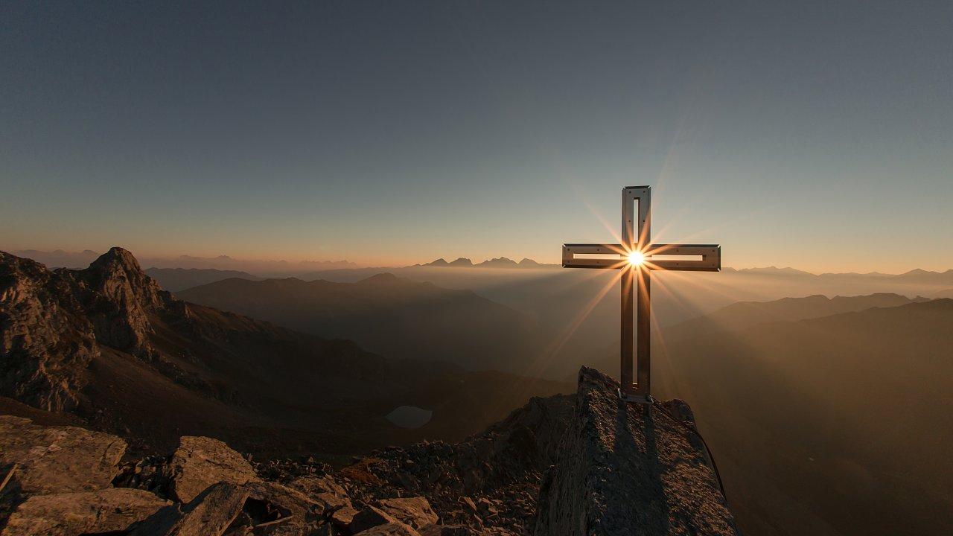
The World Suffers while the Righteous Rejoice (John 16:20-22)

Slide 3
World Rejoices | Righteous Suffer
Killing Jesus, threaten His followers (John 16:2; Matt. 27:20-22; Acts 4:18-22) | Persecution (2 Tim. 3:10-13)
Hatred for God’s Word (John 15:18-25) | While loving their enemies (Matt. 5:43-45; Acts 7:59-60)
Love evil, practice sin (John 3:19-20; 1 John 3:8) | While practicing righteousness (John 3:21; 1 John 3:7, 10)

Slide 4
World Rejoices | Righteous Suffer
Boast in their arrogance (James 4:16; Dan. 4:30) | Humble themselves under God’s mighty hand (1 Peter 5:5-7)
Lovers of pleasure (Eccl. 2:1-11; 2 Tim. 3:4-5) | Pleasing God- Obeying Him (1 Thess. 2:3-6; 4:1-8; Gal. 1:10)
Are you rejoicing with the world and its pleasures? | Or are you rejoicing along with the righteous who are suffering with Christ?
Notes:
Billy Joel- I’d rather laugh with the sinners and cry with the saints. Sinners are much more fun, only the good die young! Is that right? NO, you can’t do both. Matt. 6:24

Slide 5
World will Suffer- Hell | Righteous Enjoy Heaven
The Lord will take vengeance on the disobedient (2 Thess. 1:7-8) | Christ will relieve them of all their afflictions (2 Thess. 1:6, 10)

Slide 6
“We speak proudly of… your perseverance & faith in…all your persecutions & afflictions which you endure. This is a indication of God’s righteous judgment so that you will be considered worthy of the kingdom of God, for which indeed you are suffering. For after all it is only just for God to repay with affliction those who afflict you, & to give relief to you who are afflicted & to us as well when the Lord Jesus will be revealed from heaven with His mighty angels in flaming fire, dealing out retribution to those who do not know God & to those who do not obey the gospel of our Lord Jesus. These will pay the penalty of eternal destruction, away from the presence of the Lord and from the glory of His power, when He comes to be glorified in His saints on that day, & to be marveled at among all who have believed— for our testimony to you was believed.

Slide 7
World will Suffer- Hell | Righteous Enjoy Heaven
The Lord will take vengeance on the disobedient (2 Thess. 1:7-8) | Christ will relieve them of all their afflictions (2 Thess. 1:6, 10)
Cast into outer darkness, suffer weeping & gnashing of teeth forever (Mt. 8:11-12)

Slide 8
“I say to you that many will come from east and west, and
recline at the table with Abraham, Isaac and Jacob
in the kingdom of heaven;
but the sons of the kingdom
will be cast out into the outer darkness;
in that place there will be weeping and gnashing of teeth”
(Matthew 8:11-12).

Slide 9
World will Suffer- Hell | Righteous Enjoy Heaven
The Lord will take vengeance on the disobedient (2 Thess. 1:7-8) | Christ will relieve them of all their afflictions (2 Thess. 1:6, 10)
Cast into outer darkness, suffer weeping & gnashing of teeth forever (Mt. 8:11-12) | God shall wipe away all tears (Luke 6:21; Rev. 21:4)

Slide 10
“Blessed are you who hunger now,
for you shall be satisfied.
Blessed are you who weep now, for you shall laugh”
(Luke 6:21).
“He will wipe away every tear from their eyes;
& there will no longer be any death;
there will no longer be any mourning, or crying, or pain;
the first things have passed away”
(Revelation 21:4)

Slide 11
World will Suffer- Hell | Righteous Enjoy Heaven
The Lord will take vengeance on the disobedient (2 Thess. 1:7-8) | Christ will relieve them of all their afflictions (2 Thess. 1:6, 10)
Cast into outer darkness, suffer weeping & gnashing of teeth forever (Matt. 8:12) | God shall wipe away all tears (Luke 6:21; Rev. 21:4)
Unending agony in the lake of fire (Rev. 21:8; Mark 9:43-48)

Slide 12
“But for the cowardly
unbelieving
abominable
murderers
immoral persons
sorcerers
idolaters
& all liars,
their part will be in the lake that burns
with fire & brimstone,
which is the second death.”

Slide 13
“Whoever causes one of these little ones who believe to stumble, it would be better for him if, with a heavy millstone hung around his neck, he had been cast into the sea. If your hand causes you to stumble, cut it off; it is better for you to enter life crippled, than, having your two hands, to go into hell, into the unquenchable fire, where their worm does not die, and the fire is not quenched. If your foot causes you to stumble, cut it off; it is better for you to enter life lame, than, having your two feet, to be cast into hell, where their worm does not die, and the fire is not quenched.] If your eye causes you to stumble, throw it out; it is better for you to enter the kingdom of God with one eye, than, having two eyes, to be cast into hell, where their worm does not die, and the fire is not quenched.

Slide 14
World will Suffer- Hell | Righteous Enjoy Heaven
The Lord will take vengeance on the disobedient (2 Thess. 1:7-8) | Christ will relieve them of all their afflictions (2 Thess. 1:6, 10)
Cast into outer darkness, suffer weeping & gnashing of teeth forever (Matt. 8:12) | God shall wipe away all tears (Luke 6:21; Rev. 21:4)
Unending agony in the lake of fire (Rev. 21:8; Mark 9:43-48) | Jumping up & down for joy (Luke 6:22-23; 1 Pet. 1:8-9)

Slide 15
“Blessed are you when men hate you, and ostracize you,
and insult you, and scorn your name as evil, for the sake
of the Son of Man.
Be glad in that day and leap for joy, for behold, your
reward is great in heaven. For in the same way their
fathers used to treat the prophets” (Luke 6:22-23).
“Though you have not seen Him, you love Him, and though you do not see Him now, but believe in Him, you greatly rejoice with joy inexpressible and full of glory, obtaining as the outcome of your faith the salvation of your souls”
(1 Peter 1:8-9)

Slide 16
World will Suffer (Hell) | Righteous Enjoy Heaven
Will bow their knee & confess Jesus as Lord too late (Phil. 2:9-11)

Slide 17
For this reason also, God highly exalted Him,
& bestowed on Him the name which is above every name,
so that at the name of Jesus every knee will bow,
of those who are in heaven & on earth & under the earth,
& that every tongue will confess that Jesus Christ is Lord,
to the glory of God the Father.

Slide 18
World will Suffer (Hell) | Righteous Enjoy Heaven
Will bow their knee & confess Jesus as Lord too late (Phil. 2:9-11) | The humble will be vindicated by God (Rev. 6:9-11; 11:18; 18:20)

Slide 19
“When the Lamb broke the fifth seal, I saw underneath the
altar the souls of those who had been slain because of the
word of God, and because of the testimony which they had
maintained; and they cried out with a loud voice, saying,
“How long, Lord, holy & true, will You refrain from judging
& avenging our blood on those who dwell on the earth?”
And there was given to each of them a white robe; and
they were told that they should rest for a little while longer,
until the number of their fellow servants and their brethren
who were to be killed even as they had been, would be
completed also”

Slide 20
“And the nations were enraged, & Your wrath came, & the time came for the dead to be judged, & the time to reward Your bond-servants the prophets and the saints and those who fear Your name, the small and the great, and to destroy those who destroy the earth.”
(Revelation 11:18)
“Rejoice over her, O heaven, and you saints and apostles
and prophets, because God has pronounced judgment
for you against her” (Revelation 18:20).

Slide 21
World will Suffer (Hell) | Righteous Enjoy Heaven
Will bow their knee & confess Jesus as Lord too late (Phil. 2:9-11) | The humble will be vindicated by God (Rev. 6:9-11; 11:18; 18:20)
Eternal regret, too late to help their loved ones (Luke 16:23-28)

Slide 22
“In Hades he (rich man) lifted up his eyes, being in torment, & *saw Abraham far away & Lazarus in his bosom. He said, ‘Father Abraham, have mercy on me, & send Lazarus so that he may dip the tip of his finger in water & cool off my tongue, for I am in agony in this flame.’ But Abraham said, ‘Child, remember that during your life you received your good things, & likewise Lazarus bad things; but now he is being comforted here, and you are in agony. Besides all this, between us & you there is a great chasm fixed, so that those who wish to come over from here to you will not be able, & that none may cross over from there to us.’ He said, ‘Then I beg you, father, that you send him to my father’s house— for I have five brothers—in order that he may warn them, so that they will not also come to this place of torment.’”

Slide 23
World will Suffer (Hell) | Righteous Enjoy Heaven
Will bow their knee & confess Jesus as Lord too late (Phil. 2:9-11) | The humble will be vindicated by God (Rev. 6:9-11; 11:18; 18:20)
Eternal regret, too late to help their loved ones (Luke 16:22-28) | Singing, giving glory, thanks, & honor to God (Rev. 4:8-11; 15:3-4)

Slide 24
“The four living creatures, each one of them having six wings, are full of eyes around and within; and day and night they do not cease to say, “Holy, holy, holy is the Lord God, the Almighty, who was and who is and who is to come.” And when the living creatures give glory and honor and thanks to Him who sits on the throne, to Him who lives forever and ever, the twenty-four elders will fall down before Him who sits on the throne, and will worship Him who lives forever and ever, and will cast their crowns before the throne, saying, “Worthy are You, our Lord and our God, to receive glory and honor and power; for You created all things, and because of Your will they existed, and were created.”

Slide 25
“They sang the song of Moses, the bond-servant of God,
and the song of the Lamb, saying,
“Great and marvelous are Your works,
O Lord God, the Almighty;
Righteous and true are Your ways,
King of the nations!
“Who will not fear, O Lord, and glorify Your name?
For You alone are holy;
For all the nations will come and worship before You,
For Your righteous acts have been revealed.”

Slide 26
World will Suffer (Hell) | Righteous Enjoy Heaven
Will bow their knee & confess Jesus as Lord too late (Phil. 2:9-11) | The humble will be vindicated by God (Rev. 6:9-11; 11:18; 18:20)
Eternal regret, too late to help their loved ones (Luke 16:22-28) | Singing, giving glory, thanks, & honor to God (Rev. 4:9-11; 15:3-4)
Too late to change your mind after death. Today is the day of salvation (2 Cor. 6:2)!

Slide 27
World will Suffer (Hell) | Righteous Enjoy Heaven
Will bow their knee & confess Jesus as Lord too late (Phil. 2:9-11) | The humble will be vindicated by God (Rev. 6:9-11; 11:18; 18:20)
Eternal regret, too late to help their loved ones (Luke 16:22-28) | Singing, giving glory, thanks, & honor to God (Rev. 4:9-11; 15:3-4)
Too late to change your mind after death. Today is the day of salvation (2 Cor. 6:2)! | Jesus is the author of eternal life to all who obey Him! (Heb. 5:9; Acts 2:38)

Slide 28
Hymns for Worship at Woodmont
35- O Worship the King
249- Seek Ye First
153- By Christ Redeemed
213- Here We are but Straying Pilgrims
319- Only a Step

