Slide 1
Hymns for Worship at Woodmont
227- There is a Habitation
125- Nearer Still Nearer
189- When I Survey the Wondrous Cross
150- Purer in Heart O God
285- Zion’s Call
260- Hand in Hand with Jesus

Slide 2
Is Your Regret Leading to Salvation or Torment?
Notes:
Regret- to feel sorrow or remorse for (an act, fault, disappointment, etc.): Whether in words or deeds. We all regret something we have done. WE all likely wished that we had obeyed sooner, would have listened to wisdom, could start over again but there’s nothing we can do about that now. What we choose to do about our regrets will determine whether we will suffer eternal torment or salvation! The question we ask is your regret leading to salvation or torment.

Slide 3
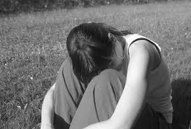

Slide 4
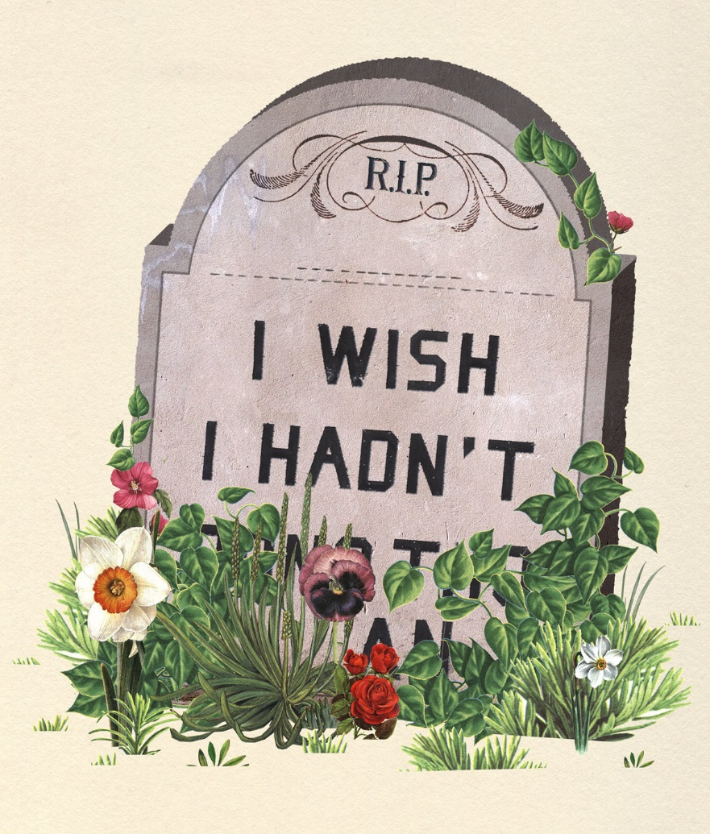
Is Your Regret Leading to Salvation or Condemnation?

Slide 5
Regret Leading to Torment | Regret Leading to Salvation
Denial of God’s will (Ps. 10:4-6; Rom. 1:28; 2 Cor. 4:4)

Slide 6
Regret leading to Torment- Deny God
“The wicked, in the haughtiness of his countenance,
does not seek Him.
All his thoughts are, “There is no God.”
His ways prosper at all times;
Your judgments are on high, out of his sight;
As for all his adversaries, he snorts at them.
He says to himself, “I will not be moved;
Throughout all generations I will not be in adversity.””
(Psalm 10:4-6)

Slide 7
Regret leading to Torment- Deny God
They rejected the evidence of God’s creation in their sin
and God gave them up to their lusts (Romans 1:18-27)
“…Just as they did not see fit to acknowledge God any
longer, God gave them over to a depraved mind, to do
those things which are not proper” (Romans 1:28)

Slide 8
Regret leading to Torment- Deny God
“…The god of this world
has blinded the minds of the unbelieving
so that they might not see
the light of the gospel
of the glory of Christ,
who is the image of God”
(2 Cor. 4:4).
Notes:
The devil has deceived them into thinking that their regret is somehow God’s fault or there is no consequences for their sin.

Slide 9
Regret Leading to Torment | Regret Leading to Salvation
Denial of God’s will (Ps. 10:4-6; Rom. 1:28; 2 Cor. 4:4) | Convicted of sin (Jn. 16:8; 2 Tim. 4:2; Jas. 2:10; Rom. 3:23)

Slide 10
Regret leading to Salvation- Convicted of Sin
“…He (Holy Spirit), when He comes, will convict the world
concerning sin & righteousness & judgment” (John 16:8).
“…Preach the word; be ready in season and out of season; reprove, rebuke, exhort, with great patience and instruction” (2 Tim. 4:2).
“Whoever keeps the whole law and yet stumbles in one point, he has become guilty of all” (James 2:10).
“All have sinned & fall short of the glory of God” (Ro. 3:23)
Notes:
This is the way God designed it to work that our regret because of our sins leads us to be convicted of our sins and realize we are guilty so that we can be on the road to redemption rather than torment.

Slide 11
Regret Leading to Torment | Regret Leading to Salvation
Denial of God’s will (Ps. 10:4, 6; Rom. 1:28; 2 Cor. 4:4) | Convicted of sin (Jn. 16:8; 2 Tim. 4:2; Jas. 2:10; Rom. 3:23)
Suffer for doing evil (Pr 1:7; 5:8-14; 6:32; 23:29f)

Slide 12
Suffer for Doing Evil- Regret to Torment
“The fear of the Lord is the beginning of knowledge;
But fools despise wisdom and instruction” (Pr. 1:7).
“The one who commits adultery with a woman is lacking
sense; he who would destroy himself does it” (Pr. 6:32).
Notes:
Those who regret on the road to ruin don’t seek God’s wisdom but despise it so that they seek after pleasure. The son isn’t listening to his father’s warning and thinks that pleasures will make him happy. The adulteress woman is warned about over and over again in the book of Proverbs.

Slide 13
Suffer for Doing Evil- Regret to Torment
“Keep your way far from her (the adulteress) & do not go near the door of her house, or you will give your vigor to others & your years to the cruel one; & strangers will be filled with your strength & your hard-earned goods will go to the house of an alien; & you groan at your final end, when your flesh and your body are consumed; & you say, “How I have hated instruction! & my heart spurned reproof! “I have not listened to the voice of my teachers, nor inclined my ear to my instructors! “I was almost in utter ruin in the midst of the assembly and congregation.””
(Proverbs 5:8-14)
Notes:
Now you see the regret when they begin to suffer the consequences for the choices that they have made. How many adulterous relationships have led to the loss of what they have worked for all their lives, the loss of their children in the divorce to their spouse, paying child support, suffering the consequence of STD’s.

Slide 14
Suffer for Doing Evil- Regret to Torment
“Who has woe? Who has sorrow? Who has contentions? Who has complaining? Who has wounds without cause? Who has redness of eyes? Those who linger long over wine, those who go to taste mixed wine. Do not look on the wine when it is red, when it sparkles in the cup, when it goes down smoothly; At the last it bites like a serpent & stings like a viper. Your eyes will see strange things & your mind will utter perverse things. And you will be like one who lies down in the middle of the sea, or like one who lies down on the top of a mast. “They struck me, but I did not become ill; they beat me, but I did not know it. When shall I awake? I will seek another drink.”” (Prov. 23:29-35).
Notes:
Alcohol is so deceiving because you drink and it is smooth and the commercials display it as being fun, you have a great time, open up your inhibitions if you are shy. You can forget about your regrets. Just one drink. The devil doesn’t want you to think about the first drink possibly leading to become an alcoholic, the DT’s, the blackouts, the bruises, the beaten spouses or children, or all the people that have been killed on the roads because of drunk driving and the desire for more.

Slide 15
Regret Leading to Torment | Regret Leading to Salvation
Denial of God’s will (Ps. 10:4, 6; Rom. 1:28; 2 Cor. 4:4) | Convicted of sin (Jn. 16:8; 2 Tim. 4:2; Jas. 2:10; Rom. 3:23)
Suffering for doing evil (Pr 1:7; 5:8-13; 6:32; 23:29f) | Godly sorrow (Acts 2:36-37; 2 Cor. 7:8-10)
Notes:
The one who is on the road to redemption in response to his regret is convicted of sin like those on the Day of Pentecost who had taken part in having Jesus crucified. They had been stirred up by the religious leaders.

Slide 16
Regret leading to Salvation- Godly Sorrow
The apostle Peter preached,
“Therefore let all the house of Israel know for certain that
God has made Him both Lord and Christ—
this Jesus whom you crucified.
Now when they heard this, they were pierced to the heart,
and said to Peter and the rest of the apostles,
“Brethren, what shall we do?””
(Acts 2:36-37)
Notes:
There was something they could do to get the forgiveness of sins and have a good conscience instead of living the regret of crucifying their Messiah the rest of their lives.

Slide 17
Regret leading to Salvation- Godly Sorrow
The apostle Paul said to the Corinthian brethren,
“Though I caused you sorrow by my letter, I do not regret it; though I did regret it—for I see that that letter caused you sorrow, though only for a while— I now rejoice, not that you were made sorrowful, but that you were made sorrowful to the point of repentance; for you were made sorrowful according to the will of God, so that you might not suffer loss in anything through us. For the sorrow that is according to the will of God produces a repentance without regret, leading to salvation, but the sorrow of the world produces death” (2 Cor. 7:8-10).
Notes:
Godly sorrow produces repentance leading to salvation while worldly sorrow produces death.

Slide 18
Regret Leading to Torment | Regret Leading to Salvation
Denial of God’s will (Ps. 10:4, 6; Rom. 1:28; 2 Cor. 4:4) | Convicted of sin (Jn. 16:8; 2 Tim. 4:2; Jas. 2:10; Rom. 3:23)
Suffering for doing evil (Pr 1:7; 5:8-13; 6:32; 23:29f) | Godly sorrow (Acts 2:36-37; 2 Cor. 7:8-10)
Pride- Refuse to change (Pr. 16:18; Jer. 5:3; Rv. 2:21)
Notes:
While there were many who were willing to obey, about 3,000, the rest of the multitude didn’t at that time. Most of them never did. Likely pride was the main reason. Warning about pride, choosing to refuse to respond to the gospel of Christ which will help them

Slide 19
Refuse to Change- Regret to Torment
“Pride goes before destruction, &
a haughty spirit before stumbling” (Prov. 16:18).
“O Lord, do not Your eyes look for truth?
You have smitten them,
But they did not weaken;
You have consumed them,
But they refused to take correction.
They have made their faces harder than rock;
They have refused to repent” (Jer. 5:3).
Notes:
The Jews had refused to repent over and over again in their history. If you choose pride it’s going to lead you on the road to ruin rather than redemption.

Slide 20
Refuse to Change- Regret to Torment
The Son of God rebuked the church at Thyatira for
tolerating Jezebel who was leading His servants astray,
and said to them,
“I gave her time to repent,
and she does not want to repent
of her immorality”
(Rev. 2:21)
Notes:
They were told to repent but they refused in the church at Thyatira. So it’s not just unbelievers.

Slide 21
Regret Leading to Torment | Regret Leading to Salvation
Denial of God’s will (Ps. 10:4, 6; Rom. 1:28; 2 Cor. 4:4) | Convicted of sin (Jn. 16:8; 2 Tim. 4:2; Jas. 2:10; Rom. 3:23)
Suffer for doing evil (Pr 1:7; 5:8-13; 6:32; 23:29f) | Godly sorrow (Acts 2:36-37; 2 Cor. 7:8-10)
Pride- refuse to change (Pr. 16:18; Jer. 5:3; Rv. 2:21) | Repent- changing will (Luke 15:7, 2 Cor. 7:11-13)

Slide 22
Regret leading to Salvation- Repentance
The apostle Paul said to the Corinthian brethren,
“For behold what earnestness this very thing, this godly sorrow, has produced in you: what vindication of yourselves, what indignation, what fear, what longing, what zeal, what avenging of wrong! In everything you demonstrated yourselves to be innocent in the matter. So although I wrote to you, it was not for the sake of the offender nor for the sake of the one offended, but that your earnestness on our behalf might be made known to you in the sight of God. For this reason we have been comforted” (2 Cor. 7:11-13).
Notes:
The Corinthian brethren showed that they repented of their sins that he had written about in the 1st letter especially concerning the withdrawn from fornicator.

Slide 23
Regret leading to Salvation- Repentance
“There will be more joy in heaven
over
one sinner who repents
than over
ninety-nine righteous persons
who need no repentance”
(Luke 15:7)
Notes:
There is joy in repentance as the Lord has provided redemption for even one lost sinner.

Slide 24
Regret Leading to Torment | Regret Leading to Salvation
Denial of God’s will (Ps. 10:4, 6; Rom. 1:28; 2 Cor. 4:4) | Convicted of sin (Jn. 16:8; 2 Tim. 4:2; Jas. 2:10; Rom. 3:23)
Suffer for doing evil (Pr 1:7; 5:8-13; 6:32; 23:29f) | Godly sorrow (Acts 2:36-37; 2 Cor. 7:8-10)
Pride- refuse to change (Pr. 16:18; Jer. 5:3; Rv. 2:21) | Repent- changing will (Luke 15:7, 2 Cor. 7:11-13)
Not sorry for rebellion (Jer. 6:15-16; Luke 7:28-30)

Slide 25
Not Sorry for Rebellion- Regret to Torment
“Were they ashamed because of the abomination they
have done? They were not even ashamed at all;
They did not even know how to blush. Therefore they
shall fall among those who fall; at the time that I punish
them, they shall be cast down,” says the Lord.
Thus says the Lord, “Stand by the ways & see & ask for
the ancient paths, Where the good way is, & walk in it;
And you will find rest for your souls.
But they said, ‘We will not walk in it.’” (Jer. 6:15-16).
Notes:
They refused to be sorry for their rebellious activity and had gotten to the point where they didn’t even blush at sin. Invitation to walk in the ancient paths where you would find rest for your souls instead of regret.

Slide 26
Not Sorry for Rebellion- Regret to Torment
Jesus said, “I say to you, among those born of women
there is no one greater than John; yet he who is least in
the kingdom of God is greater than he.”
When all the people and the tax collectors heard this, they
acknowledged God’s justice, having been baptized with the
baptism of John.
But the Pharisees and the lawyers rejected
God’s purpose for themselves,
not having been baptized by John” (Luke 7:28-30).
Notes:
The Pharisees and lawyers refused the baptism of John and thus refused God’s purpose for themselves.

Slide 27
Regret Leading to Torment | Regret Leading to Salvation
Denial of God’s will (Ps. 10:4, 6; Rom. 1:28; 2 Cor. 4:4) | Convicted of sin (Jn. 16:8; 2 Tim. 4:2; Jas. 2:10; Rom. 3:23)
Suffering for doing evil (Pr 1:7; 5:8-13; 6:32; 23:29f) | Godly sorrow (Acts 2:36-37; 2 Cor. 7:8-10)
Pride- refuse to change (Pr. 16:18; Jer. 5:3; Rv. 2:21) | Repent- changing will (Luke 15:7, 2 Cor. 7:11-13)
Not sorry for rebellion (Jer. 6:15-16; Luke 7:28-30) | Baptized into Christ (Acts 2:38, 41; 16:31-34; 1 Pet. 3:21)
Notes:
The penitent believer who is truly sorry for his sins will be baptized into Christ.

Slide 28
Regret leading to Salvation- Baptism in Christ
“””Repent, and each of you be baptized
in the name of Jesus Christ
for the forgiveness of your sins;
and you will receive the gift of the Holy Spirit” (Acts 2:38).
“Those who had received his word were baptized; and that
day there were added about three thousand souls” (v. 41).

Slide 29
Regret leading to Salvation- Baptism in Christ
Paul & Silas said to the Philippian jailer who asked what he
must do to be saved,
“Believe in the Lord Jesus, & you will be saved, you & your
household.” And they spoke the word of the Lord to him
together with all who were in his house. And he took them
that very hour of the night and washed their wounds, &
immediately he was baptized, he & all his household. And
he brought them into his house & set food before them, &
rejoiced greatly, having believed in God with his whole
household” (Acts 16:31-34).
Notes:
The jailer likely regretted having to hurt the apostle Paul who had been a model prisoner and saving him from suicide. But it was because of Christ that Paul learned redemption instead of regret for putting men and women in prison and casting their vote to have him killed.

Slide 30
Regret leading to Salvation- Baptism in Christ
Eight souls were brought safely through the water
“…Corresponding to that, baptism now saves you—
not the removal of dirt from the flesh,
but an appeal to God for a good conscience—
through the resurrection of Jesus Christ”
(1 Peter 3:21).
Notes:
We all likely have regretted decisions that we have made and wish that we could turn back the clock. You can’t change what has happened in the past but you can change your regrets into repentance and your condemnation into redemption through the blood of Jesus Christ (2 Cor. 7:10; Eph. 1:7).

Slide 31
Regret leading to Salvation- Baptism in Christ
Eight souls were brought safely through the water
“…Corresponding to that, baptism now saves you—
not the removal of dirt from the flesh,
but an appeal to God for a good conscience—
through the resurrection of Jesus Christ”
(1 Peter 3:21).
Notes:
Regret first drink, first toke, first look at pornography, first taste of SI, first time to gamble, etc. Many souls living with eternal regret in pain and agony for they will never be able to escape forever and ever while the saints are rejoicing in heaven.

