Slide 1
Abraham’s Offering of Isaac (Genesis 22)

Slide 2
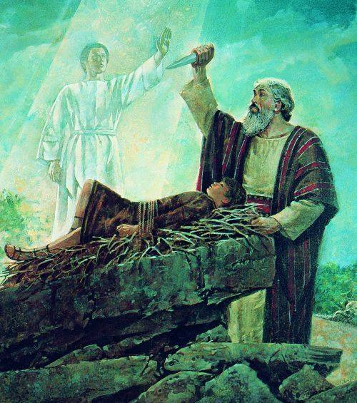

Slide 3
Abraham’s Faith in Offering Isaac (Gen. 22)
God Allows the Faithful to be Tested (v. 1)
(Deuteronomy 8:2; Matthew 4:3-4; James 1:2-4)
He Didn’t Hesitate to Obey God- [Faith without works is dead] (v. 2-4)
(Hebrews 11:8-10; James 2:20-24)
God Provided a Sacrifice to Fulfill His Plan for Man (v. 7-8, 13-14)
(John 1:29; 3:16; 10:18; Rom. 5:8; 12:1; 1 Peter 1:18-19)
He Demonstrated Obedience to the Point of Death (v. 10-12, 18)
(Romans 4:16-25; Hebrews 5:8-9; Revelation 2:10; Matthew 16:24-26)
God Will Raise the Dead
(Hebrews 11:17-19; John 11:25; Acts 2:32; 1 Corinthians 15:50-58)

Slide 4
Application to Your Life
Do you realize that God provided the ‘Lamb’ so that you can be forgiven of
your sins through the blood of Christ so that you can be saved?
When you are tested in your faith, will you consider it joyful and grow spiritually or
doubt & be deceived into thinking that faith only will save you?
Will you offer your body as a living sacrifice for God’s purposes or your own?
Are you putting to death the deeds in the body or are you still living in them?
Will you be raised from the dead to eternal life or to torment by the Lord?
If you aren’t prepared for the Judgment, we encourage you to respond to the Lord’s
invitation to believe & be baptized so that you might be saved (Mark 16:15-16).

