Slide 1
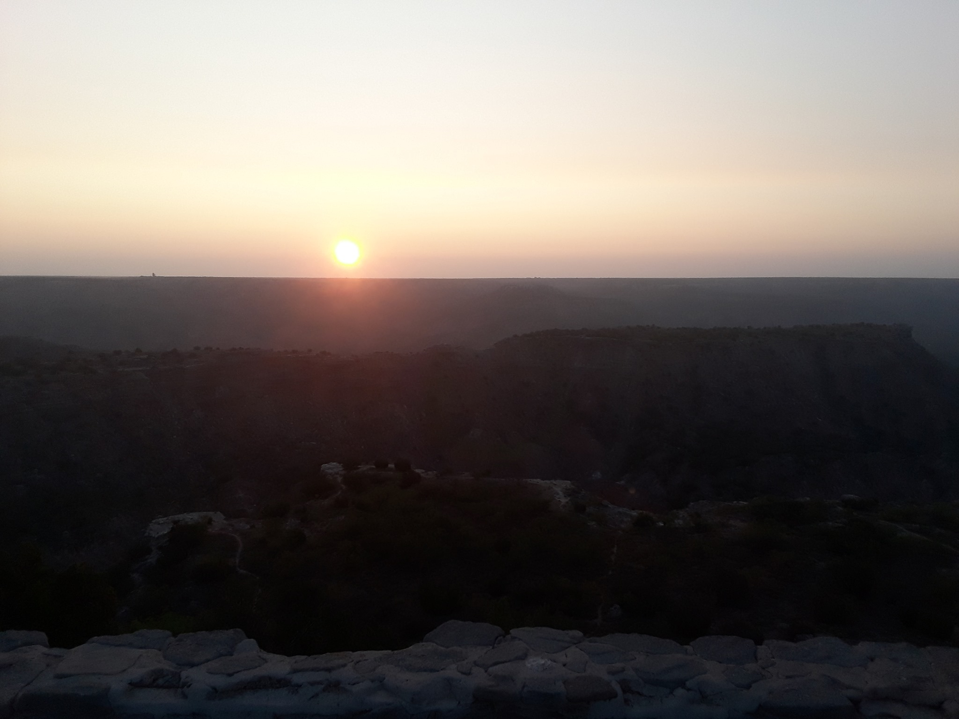
Be Still and Know that I Am God

Slide 2
Be Still & Know that I Am God (Ps. 46:10)
He’s the Creator (Ps. 19:1; 33:6-9; 8:3-4; Rom. 1:20; Isa. 40:26)
He’s the Revelator (Jn. 1:1, 14; 14:26; Eph. 3:3-5; 1 Cor. 2:10-12)
He’s the Redeemer (Isa. 44:6, 21-24; Eph. 1:3-7; 1 Pet. 1:18-19)
He’s the Commander (Eph. 1:20-23; Matt. 28:18-20; 2 Tim. 2:3)
He’s the Holy One (Lev. 11:44; 1 Pet. 1:13-16)
He’s the Comforter (Ps. 46:1; 2 Cor. 1:3ff; Heb. 4:14-16)
He’s the Shepherd (Ps. 23:1ff; John 10:11-19; 27-30)
He’s the Judge (John 5:22, 28-29; 12:48-50; 2 Cor. 5:10; 2 Tim. 4:8)

Slide 3
Be Still & Know that I Am God (Ps. 46:10)
Since He’s the Creator, are you worshiping Him with reverence or negligence?
Since He’s the Revelator, are you reading so as to understand the Scriptures?
Since He’s the Redeemer, have you been washed (baptized) in the blood of the Lamb?
Since He’s the Commander, are you enduring hardship as a good soldier of Christ?
Since He’s the Holy One, are you living a holy life that would please Him?
Since He’s the Comforter, are you suffering for Christ so there is a need for comfort?
Since He’s the Shepherd, are you following Him or being deceived by a stranger?
Since He’s the Judge, are you prepared for the Judgment or fearful of that day?

