Slide 1
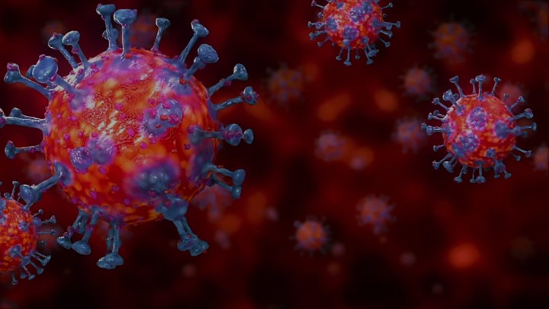
In this Present Distress…

Slide 2
A distress was going on Corinth
“Now concerning virgins I have no command of the Lord,
but I give an opinion as one who by the mercy of the Lord
is trustworthy. I think then that this is good in view of the
present distress, that it is good for a man to remain as he
is” (1 Cor. 7:25-26).
Paul was not against marriage, but with the distress going on his opinion was it would be better not to marry. During our present distress many have decided to postpone their wedding to obey the laws of limiting gathering together.

Slide 3
During this Present Distress We Must…
Obey the Governing Authorities
(Rom. 13:1-2; 1 Pet. 2:13-15)
[Tarrant County- No In Person Worship Services Permitted]
-Therefore we can’t worship together but can go online
-This is temporary until we are allowed to meet together
as God commands (Heb. 10:25; John 4:24)
-This is not persecution from the government (Acts 5:29)

Slide 4
During this Present Distress We Must…
Obey the Governing Authorities
“Everyone is to submit to the governing authorities.
For there is no authority except from God,
& those which exist are established by God.
Therefore whoever resists authority
has opposed the ordinance of God;
& they who have opposed
will receive condemnation upon themselves…

Slide 5
During this Present Distress We Must…
Obey the Governing Authorities
…For rulers are not a cause of fear
for good behavior,
but for evil.
Do you want to have no fear of authority?
Do what is good &
you will have praise from the same;
for it is a minister of God to you for good…

Slide 6
During this Present Distress We Must…
Obey the Governing Authorities
…But if you do what is evil, be afraid;
for it does not bear the sword for nothing;
for it is a minister of God,
an avenger who brings wrath on the evildoer.
Therefore it is necessary to be in subjection,
not only because of wrath, but also for conscience’ sake”
(Rom. 13:1-5)

Slide 7
During this Present Distress We Must…
Obey the Governing Authorities
“Submit yourselves for the Lord’s sake to every human
institution, whether to a king as the one in authority,
or to governors as sent by him for the punishment of
evildoers & the praise of those who do right.
For such is the will of God that by doing right
you may silence the ignorance of foolish men”
(1 Peter 2:13-15)

Slide 8
During this Present Distress We Must…
Obey the Governing Authorities
(Rom. 13:1-2; 1 Pet. 2:17)
Obey our Elders Decision
to Study Online if it is Possible
(Heb. 13:7, 17; 1 Pet. 5:1-4)

Slide 9
During this Present Distress We Must…
Obey our Elders Decision to Study Online

Slide 10
During this Present Distress We Must…
Obey our Elders Decision to Study Online
“Remember those who led you,
who spoke the word of God to you;
& considering the result of their conduct,
imitate their faith”
(Heb. 13:7)

Slide 11
During this Present Distress We Must…
Obey our Elders Decision to Study Online
”Obey your leaders and submit to them,
for they keep watch over your souls as those
who will give an account.
Let them do this with joy and not with grief,
for this would be unprofitable for you”
(Heb. 13:17)

Slide 12
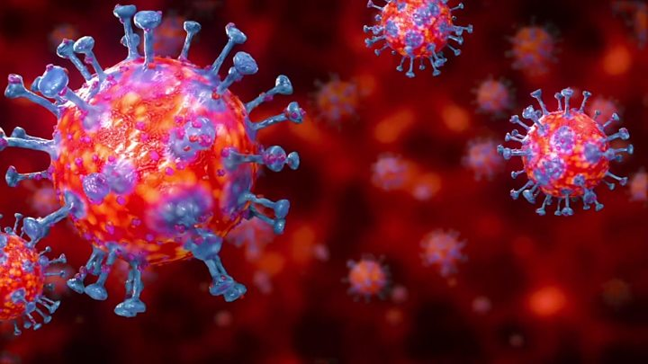
What are You Learning in this Present Distress?

Slide 13
What Can You Learn from this Distress?
God is Still in Control
“The Lord is in His holy temple.
Let all the earth be silent before Him.”
(Habakkuk 2:20)

Slide 14
What Can You Learn from this Distress?
God is Still in Control
After Jesus is raised from the dead He said,
“All authority has been given to Me
in heaven and on earth”
(Matthew 28:18)

Slide 15
What Can You Learn from this Distress?
God is Still in Control
“declared the Son of God with
power by the resurrection from the dead,
according to the Spirit of holiness,
Jesus Christ our Lord”
(Rom. 1:4)

Slide 16
What Can You Learn from this Distress?
God is Still in Control
Humbling Your Pride
(Isa. 55:6-9; Dan. 4:37; 1 Pet. 5:6)

Slide 17
What Can You Learn from this Distress?
Humbling your Pride
“Seek the Lord while He may be found;
Call upon Him while He is near.
Let the wicked forsake his way
And the unrighteous man his thoughts;
And let him return to the Lord,
And He will have compassion on him,
And to our God,
For He will abundantly pardon…

Slide 18
What Can You Learn from this Distress?
Humbling your Pride
…“For My thoughts are not your thoughts,
Nor are your ways My ways,” declares the Lord.
“For as the heavens are higher than the earth,
So are My ways higher than your ways
And My thoughts than your thoughts”
(Isaiah 55:6-9)

Slide 19
What Can You Learn from this Distress?
Humbling your Pride
“Now I, Nebuchadnezzar, praise, exalt and honor the King of heaven, for all His works are true and His ways just, and He is able to humble those who walk in pride.”
(Daniel 4:37)

Slide 20
What Can You Learn from this Distress?
Humbling your Pride
“…all of you, clothe yourselves with humility toward
one another, for God is opposed to the proud,
but gives grace to the humble.
Therefore humble yourselves under the mighty hand
of God, that He may exalt you at the proper time”
(1 Peter 5:5-6)

Slide 21
What Can You Learn from this Distress?
God is Still in Control
(Hab. 2:20; Matt. 28:18; Rom. 1:4)
The Need to Humble Your Pride
(Isa. 55:6-9; Dan. 4:37; 1 Pet. 5:6)
To Be Grateful instead of Grumbling

Slide 22
What Can You Learn from this Distress?
To be Grateful instead of Grumbling
“In everything give thanks;
for this is God’s will for you
in Christ Jesus”
(1 Thess. 5:18)

Slide 23
What Can You Learn from this Distress?
To be Grateful instead of Grumbling
“Do everything without grumbling
or
disputing”
(Phil. 2:14)

Slide 24
What Can You Learn from this Distress?
To be Grateful instead of Grumbling
Don’t imitate the Israelites in the wilderness
“Nor grumble, as some of them did,
and were destroyed by the destroyer”
(1 Cor. 10:11)

Slide 25
What Can You Learn from this Distress?
Pray Fervently that God’s Will be Done

Slide 26
What Can You Learn from this Distress?
Pray Fervently that God’s Will be Done
Jesus prayed in the Garden of Gethsemane,
“Father, if You are willing, remove this cup
from Me; yet not My will,
but Yours be done.”
(Luke 22:42)

Slide 27
What Can You Learn from this Distress?
Pray Fervently that God’s Will be Done
“…confess your sins to one another, and
pray for one another so that you may be healed.
The effective prayer of a righteous man can
accomplish much”
(James 5:16)

Slide 28
What Can You Learn from this Distress?
Pray Fervently that God’s Will be Done
“Devote yourselves to prayer, keeping alert in it with
an attitude of thanksgiving; praying at the same time
for us as well, that God will open up to us a door for
the word, so that we may speak forth the mystery of
Christ, for which I have also been imprisoned; that
I may make it clear in the way I ought to speak…

Slide 29
What Can You Learn from this Distress?
Pray Fervently that God’s Will be Done
…Conduct yourselves with wisdom toward outsiders,
making the most of the opportunity.
Let your speech always be with grace,
as though seasoned with salt,
so that you will know how you should respond
to each person” (Col. 4:2-6).

Slide 30
What Can You Learn from this Distress?
Pray Fervently that God’s Will be Done
“about midnight Paul and Silas were
praying and singing hymns of praise to God,
and the prisoners were listening to them.
(Acts 16:25)

Slide 31
What Can You Learn from this Distress?
Pray Fervently that God’s Will be Done
(Luke 22:42; Jas. 5:16; Col. 4:2-6; Acts 16:25)
There May Be Open Doors to Save Souls

Slide 32
What Can You Learn from this Distress?
There May Be Open Doors to Save Souls
“A vision appeared to Paul in the night: a man
of Macedonia was standing & appealing to him,
& saying, “Come over to Macedonia & help us.”
When he had seen the vision, immediately we
sought to go into Macedonia, concluding that
God had called us to preach the gospel to them”
(Acts 16:9-10)

Slide 33
What Can You Learn from this Distress?
There May Be Open Doors to Save Souls
The Philippian jailer was about to commit suicide thinking the prisoners were about to escape after the earthquake occurred but Paul told him not to do it because they were all there and the jailer asked,
“Sirs, what must I do to be saved?” They said,
“Believe in the Lord Jesus, & you will be saved,
you and your household….

Slide 34
What Can You Learn from this Distress?
There May Be Open Doors to Save Souls
…And they spoke the word of the Lord to him together with all who were in his house. And he took them that very hour of the night & washed their wounds, & immediately he was baptized, he & all his household. And he brought them into his house and set food before them, and rejoiced greatly, having believed in God with his whole household”
(Acts 16:31-34).

Slide 35
What Can You Learn from this Distress?
There May Be Open Doors to Save Souls
“I want you to know, brethren, that my
circumstances have turned out
for the greater progress of the gospel,
so that my imprisonment in the cause of Christ
has become well known throughout the whole
praetorian guard & to everyone else…

Slide 36
What Can You Learn from this Distress?
There May Be Open Doors to Save Souls
…and that most of the brethren,
trusting in the Lord
because of my imprisonment,
have far more courage to speak
the word of God without fear”
(Phil. 1:12-14)

Slide 37
What Can You Learn from this Distress?
Pray Fervently that God’s Will be Done
(Luke 22:42; Jas. 5:16; Col. 4:2-6; Acts 16:25)
There May Be Open Doors to Save Souls
(Acts 16:9-10, 31-34; Phil. 1:12-14)
Love God & Your Neighbor as Yourself

Slide 38
What Can You Learn from this Distress?
Love God & Your Neighbor as Yourself
“‘You shall love the Lord your God
with all your heart, & with all your soul,
& with all your mind.’
This is the great & foremost commandment.
The second is like it,
‘You shall love your neighbor as yourself.’
(Matt. 22:37-39)

Slide 39
What Can You Learn from this Distress?
Love God & Your Neighbor as Yourself
A lawyer answered Jesus correctly with these words
but he was testing Jesus and was desiring to justify
himself and so he asked, “who is my neighbor”
Jesus gave an example of a man being beaten
and robbed and left for dead. A priest and a Levite
passed him by on the other side but the Samaritan
had compassion on him & took care of his needs.

Slide 40
What Can You Learn from this Distress?
Love God & Your Neighbor as Yourself
Jesus asked the lawyer,
“Which of these three do you think proved to be a
neighbor to the man who fell into the robbers’ hands
And he said,
“The one who showed mercy toward him.”
Then Jesus said to him, “Go & do the same.”
(Luke 10:36-37)

Slide 41
What Can You Learn from this Distress?
Love God & Your Neighbor as Yourself
“Therefore as we have opportunity
let us do good to all people and
especially those who are
of the household of faith”
(Gal. 6:10).

Slide 42
What Can You Learn from this Distress?
To be at Peace instead of being Anxious

Slide 43
What Can You Learn from this Distress?
To be at Peace instead of being Anxious
Jesus said to His disciples,
These things I have spoken to you,
so that in Me you may have peace.
In the world you have tribulation,
but take courage; I have overcome the world.”
(John 16:33)

Slide 44
What Can You Learn from this Distress?
To be at Peace instead of being Anxious
“Be anxious for nothing, but in everything
by prayer and supplication with thanksgiving
let your requests be made known to God.
And the peace of God, which surpasses all
comprehension, will guard your hearts
and your minds in Christ Jesus” (Phil. 4:6-7).

Slide 45
What Can You Learn from this Distress?
To be Content instead of Miserable

Slide 46
What Can You Learn from this Distress?
To be Content instead of Miserable
“I have learned in whatever state I am in to be
content. I know how to get along with humble
means, & I also know how to live in prosperity;
in any & every circumstance I have learned the secret
of being filled & going hungry, both of having
abundance & suffering need. I can do all things
through Christ who strengthens me” (Phil. 4:11-13).

Slide 47
What Can You Learn from this Distress?
To be Content instead of Miserable
“Godliness with contentment is great gain.
For we have brought nothing into the world,
so we cannot take anything out of it either.
If we have food and covering,
with these we shall be content…

Slide 48
What Can You Learn from this Distress?
To be Content instead of Miserable
“But those who want to get rich fall into temptation and a snare and many foolish and harmful desires which plunge men into ruin and destruction. For the love of money is a root of all sorts of evil, & some by longing for it have wandered away from the faith & pierced themselves with many griefs” (1 Tim. 6:6-10).

Slide 49
What Can You Learn from this Distress?
To Persevere with Joy

Slide 50
What Can You Learn from this Distress?
To Persevere with Joy
“Consider it all joy, my brethren,
when you encounter various trials, knowing that
the testing of your faith produces endurance.
And let endurance have its perfect result,
so that you may be perfect & complete,
lacking in nothing” (James 1:2-4)

Slide 51
What Can You Learn from this Distress?
To Persevere with Joy
“Blessed is a man who perseveres under trial;
for once he has been approved,
he will receive the crown of life which
the Lord has promised to those who love Him”
(James 1:12)

Slide 52
What Can You Learn from this Distress?
To Persevere with Joy
“As an example, brethren, of suffering & patience,
take the prophets who spoke in the name of the
Lord. We count those blessed who endured.
You have heard of the endurance of Job & have
seen the outcome of the Lord’s dealings,
that the Lord is full of compassion & is merciful.
(James 5:10-11)

Slide 53
What Can You Learn from this Distress?
To Persevere with Joy
“Therefore, my beloved brethren,
be steadfast, immovable,
always abounding in the work of the Lord,
knowing that your toil
is not in vain in the Lord”
(1 Cor. 15:58)

