Slide 1
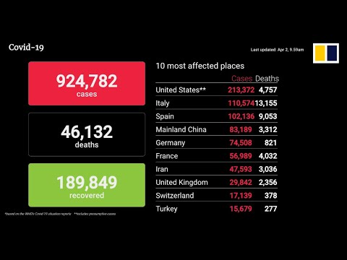
The 10 Most Affected Places- Coronavirus

Slide 2
The Exponential Growth of the Coronavirus
About 2.3 million cases in the world with over 159,000 deaths.
The US- c. 730,000 cases with 38,000 dead (almost 10x in 3 weeks)
The faster the infection rate rises, the harder it is to care for patients.
“Flattening the curve”- slowing down the spread of the virus
Shelter in place/social distancing guidelines are to help flatten the curve.
It appears that the curve of the virus is flattening out in the US.
Our governor plans to open up more businesses soon.

Slide 3
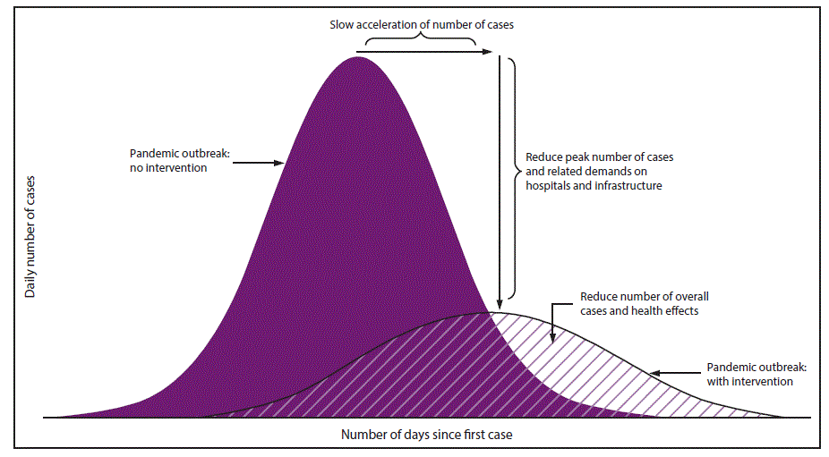
Flattening the Curve of the Coronavirus

Slide 4
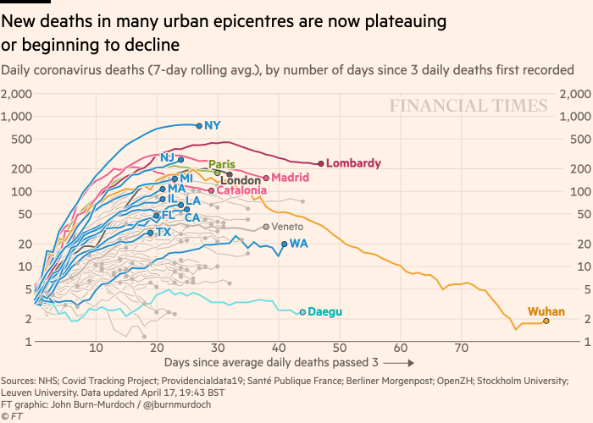
Flattening the Curve of the Coronavirus

Slide 5
The Curse of Sin (transgressing God’s Law)
“Just as through one man sin entered into the world,
and death through sin,
and so death spread to all men,
because all sinned” (Romans 5:12).
When Adam & Eve were in the Garden of Eden they had perfect
fellowship with God with His love, peace, joy, & protection.
They died the day they partook of the forbidden fruit as God promised
(spiritually- Gen. 3:3, 6). The ground was cursed, mankind would
suffer pain, & all would eventually die (Gen. 3:16, 19; Heb. 9:27).

Slide 6
God Flattened the Spread of Sin
God saw that the sin among His creation was increasing exponentially
He decided to “flatten” (blot out) man from the earth (Gen. 6:5).
Noah found grace in the Lord’s eyes and built an ark, preached
righteousness to the people so they might repent, and 8 souls were
saved in the ark while everyone else drowned (Gen. 6:8; 2 Pet. 2:5; 3:9).
When the sin of homosexuality had proliferated in Sodom “God flattened”
the city with fire & brimstone when there couldn’t be found 10 righteous
souls there but He saved Lot.
(Gen. 18:32; 19:24-29; 2 Peter 2:6-8; Jude 1:7)

Slide 7
God Flattened the Spread of Sin
God “flattened” (punished) the evildoers in the wilderness for their
grumbling and lack of faith (Num. 14:26-29).
God “flattened” the northern (Israel) & southern kingdom (Judah) for their
rebellion & sent them into Assyrian & Babylonian captivity (2 Kings 17:7-23)
They feared other gods & walked in the customs of the nations (v. 8)
They worshiped & served idols (v. 10-12, 16)
They made their children pass through the fire (v. 17)
God “cast them out of His sight” (v. 18, 20, 23)

Slide 8
God Flattened the Spread of Sin through His Son
God demonstrated His love for mankind when He gave His Son who willingly
died on the cross for the sins of the world (John 3:16; Rom. 5:8; 1 Jn. 2:2)
The wages of sin is death but the gift of God is eternal life (Rom. 6:23)
There is now no condemnation for those who are in Christ (Rom. 8:1-4)
Knowing the truth will set you free from your sins (John 8:31-32)
The Bible gives evidence that Jesus is the Son of God (John 20:30-31)
The gospel was to be preached to all-
Believe, repent, confess & be baptized to be forgiven of your sins
(Mark 16:15-16; Luke 24:47; Acts 8:37)

Slide 9
Gospel Spreads- Sins Forgiven, Multiplied Growth
About 3,000 joyfully received the word by being baptized (Acts 2:41)
The number grew to 5,000 (Acts 4:4)
There was an exponential growth of Jews being saved (Acts 6:7)
Persecution doesn’t silence the brethren from teaching others (Acts 8:4)
The gospel spread to Judea, Galilee, and Samaria (Acts 9:31)
The Gentiles are saved beginning with Cornelius (Acts 10:48)
The good news reached Phoenicia, Cyprus, & Antioch (Acts 11:19-21)
Saul is converted, gospel is preached to the whole world (Col. 1:23)

Slide 10
False Teachers Spread Lies, Many Followed (2 Pt. 2:1-3)
They entice by fleshly desires [greedy, adulterous] (2 Pet. 2:13-15)
They promised freedom while they were enslaved to sin (2 Pet. 2:18-19)
Hymenaeus & Philetus taught the resurrection had already happened and
their influence had spread among brethren like cancer (2 Tim. 2:17).
Paul warned Timothy that evil men would corrupt others (2 Tim. 3:13).
Timothy must do his best to stop the spread of sin by preaching the word.
Elders must stop the mouths of false teachers (2 Tim. 3:14-4:5; Tit. 1:11)
As Christians, we have the responsibility to spread the gospel so as to save
souls, and flatten sin’s corrupting influence on others (Matt. 5:13-16)!

Slide 11
Christians Must Spread the Gospel, Flatten Sin with Truth
Pray for open doors for the gospel and that it might spread rapidly.
(Col. 4:2-6; 2 Thess. 3:1)
Plant the seed of the gospel, water it, God will cause the growth in a good
and honest heart (Luke 8:11, 15, 1 Cor. 3:5-6)
Teach the faithful so they might teach others so that they might be saved.
Expose evil deeds with the light of truth (2 Tim. 2:2, 24-26; Eph. 5:11).
Try to restore those who have fallen back into the practice of sin so that
their soul might be saved from death (Gal. 6:1; James 5:19-20).
Let us practice righteousness instead of sin and when we realize that we
have transgressed God’s law, repent & pray for forgiveness (1 John 1:7-10).

Slide 12
Conclusion
We all have to suffer because of the Coronavirus as we have seen it
becoming a pandemic and many have died from it.
We are all going to die but we don’t have to die in our sins with guilt on our
soul before a holy and righteous God who will judge us in the last day.
God sent His Son to “flatten” it out so that we can have the forgiveness of
sins through His shed blood by obeying Jesus Christ (Heb. 5:8-9).
After we become Christians, the Lord desires that we spread the good news
so that souls might be saved, and stop the corrupting influence of sin
which will lead many souls to be lost in hell. Are you doing your part?
Don’t grow weary in doing good. We’ll reap if we don’t give up!

