Slide 1
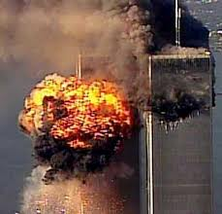
Have You Forgotten?

Slide 2
Have You Forgotten…
“Have you forgotten how it felt that day to see your homeland under
fire and her people blown away. Have you forgotten when those
towers fell we had neighbors still inside…
Have you forgotten all the people killed some went down like heroes in
that Pennsylvania field. Have you forgotten about our Pentagon all
the loved ones that we lost and those left to carry on.”
(Darryl Worley- Have you Forgotten?”)
Jesus made a spiritual application when 18 people died in a tower to the
people still living of their need to repent! (Luke 13:4-5).
Let us never forget of our need to repent so that we won’t die in our sins!

Slide 3
Have You Forgotten…
…God Your Creator?
(Jeremiah 44:4-10; 23:9-22; Romans 1:18-32)
If you have, God will punish you
(Jeremiah 44:11-14; Romans 2:5-6, 8-9)
If you have not, God will never forget you & reward you in the future
(Isa. 49:14-16; Ezk. 37:11-14, 24-28; Jn. 5:25; Eph. 2:1-7; Heb. 13:5, 20)
Have you forgotten God your Creator?
If so, God will punish those who do not obey the gospel (2 Thess. 1:7-10).
If you remember Jesus Christ, you’ll be richly rewarded (2 Tim. 2:8; 4:8)!

