Slide 1
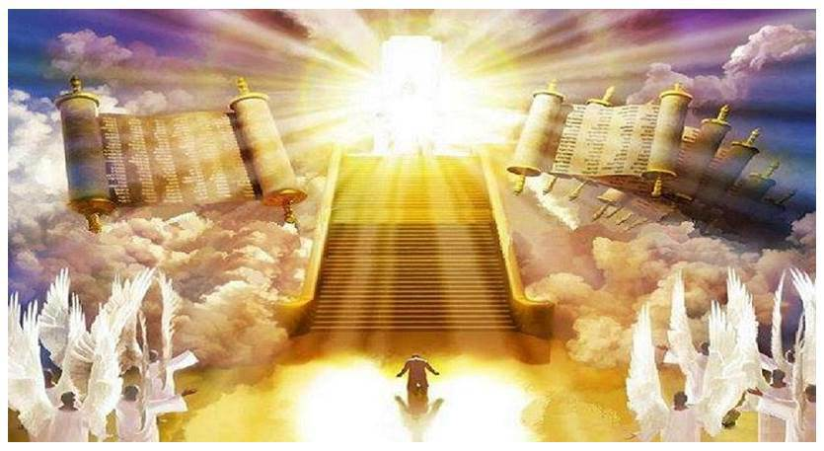
Judgment Day

Slide 2
Judgment Day is Certain after your Death (Hebrews 9:27)
Universal- Everyone will be there (Romans 14:10-12; Matthew 25:31-33)
Deeds, Words, & Motives will be Judged (Rev. 20:11-13; Matt. 12:36-37; 1 Cor. 4:5)
God’s Word is the Standard (John 12:48-50; Revelation 20:12)
Messiah (Christ) is the Judge (John 5:27; 2 Corinthians 5:10)
Execution of God’s Wrath on Ungodly (Romans 2:5; Jude 1:15; Matthew 7:13, 21-23)
Never ending Joy for the Faithful (Romans 2:7; 1 Peter 1:3-9)
Torment for the Selfish that will last Forever (Romans 2:8-9; Mark 9:43-48)

