Slide 1
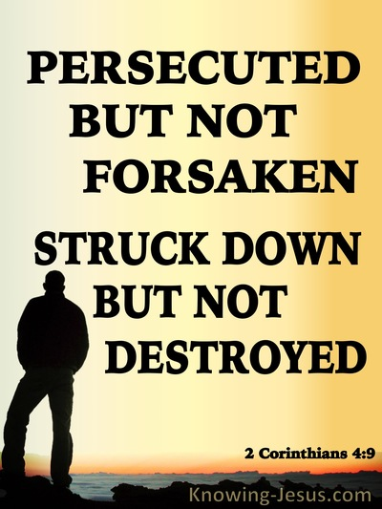
How to Endure through Persecution for Christ’s Sake
Notes:
persecution – literally, "the hunt to bring someone down like an animal," trying to suppress (punish) their convictions. literally refers to those seeking to punish God's messengers with a vengeance – like a hunter trying to conquer (obliterate) someone as their "catch."

Slide 2
1 Peter 3:13-18
“Who is there to harm you if you prove zealous for what is good?
Even if you should suffer for the sake of righteousness, you are blessed.
And do not fear their intimidation, & do not be roubled, but sanctify Christ
as Lord in your hearts, always being ready to make a defense to everyone
who asks you to give an account for the hope that is in you, yet with
gentleness and reverence; & keep a good conscience so that in the thing
in which you are slandered, those who revile your good behavior in Christ
will be put to shame. For it is better, if God should will it so, that you suffer
for doing what is right rather than for doing what is wrong. For Christ also
died for sins once for all, the just for the unjust, so that He might bring us
to God, having been put to death in the flesh, but made alive in the spirit”

Slide 3
How to Endure through Persecution for Christ’s Sake
Realize that you’re blessed, not cursed when it happens to you
(1 Peter 3:13-14a; Luke 6:22)
Don’t let them intimidate you into silence, sanctify Christ as Lord in your
hearts so that you’ll be ready to make a defense to all (1 Peter 3:14-15)
Don’t let them corrupt your conscience, your good behavior can convict
them of sin so they will get right with God (1 Peter 3:16-18; 2:12)
Remember that it shows that you aren’t ashamed of Him & are glorifying God
(1 Peter 4:12-16)
You aren’t the only one, your beloved brothers and sisters in Christ are
suffering all over the world (2 Timothy 3:12; 1 Peter 5:6-11)

Slide 4
How to Endure through Persecution for Christ’s Sake
Love your enemies instead of hating them & pray for their souls to be saved
(Matthew 5:43-48; Acts 16:22-34)
Don’t seek revenge, overcome evil by doing good [kill them with kindness]
(Romans 12:17-21; 1 Thessalonians 2:1ff)
Don’t retaliate, rejoice for the opportunity it gives you to grow spiritually
(James 1:2-4; Romans 5:3-5)
Rejoice that you have been considered to worthy to suffer shame
for His name (Acts 5:40-42) instead of complaining
Rejoice when it happens to you because your reward in heaven is great
(Matthew 5:10-12; James 1:12; 5:10-11)

Slide 5
How to Endure through Persecution for Christ’s Sake
Are you enduring persecution for Christ’s sake or trying to avoid it?
Have you been intimidated into silence or are you standing up for truth?
Has your conscience been corrupted by evildoers or convicted by Christ?
Are you loving & praying for your enemies to be saved or condemned?
Are you desiring to avenge wrong or overcoming evil with good?
Are you rejoicing when it happens (to grow spiritually, suffer shame for
Him, & realize the great reward of heaven) or are you ashamed of Him?
We are more than conquerors through Him who loved us (Rom. 8:35-39)!

