Slide 1
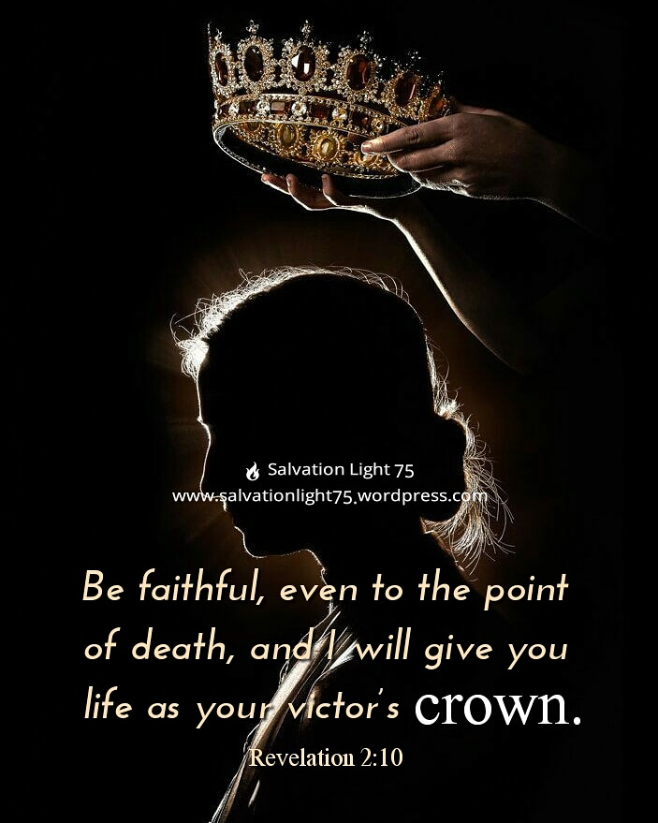
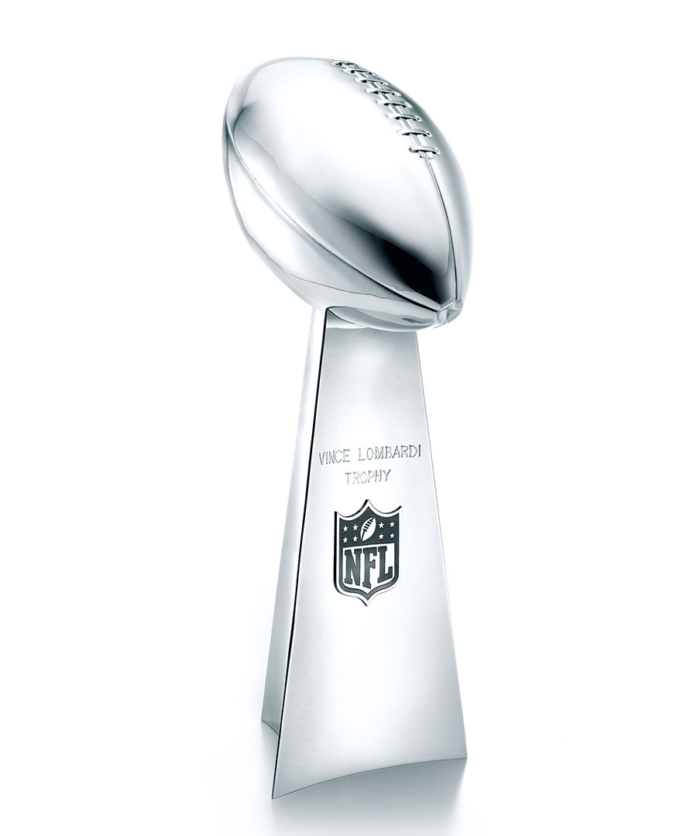
Which Prize is the Most Important?

Slide 2
Predicting the Outcome
Many people can pick the winner of the game, but very seldom will anyone
be able to predict the final score and if they do it’s just lucky.
There were about 300 OT Prophecies about the Messiah-
what are the chances of someone fulfilling all of them?
Professor Peter Stoner (1888-1980) calculated that the probability of one
man fulfilling just 48 of the 300 prophecies as one chance in 10 followed
by 157 zeros.
Compare that with the chance of winning the lottery ...
about 1 in 14 million (only 6 zeros).

Slide 3
Jesus Christ Fulfilled all the Prophecies
Born of a virgin (Isaiah 7:14; Matt. 1:22-23)
Born in Bethlehem of Judea (Micah 5:2; Matt. 2:6)
He was despised & rejected by men (Isa. 53:3; John 1:11; 12:37-38)
He would die as a sacrifice for sin (Isa. 53:5-6; 1 Cor. 15:3-4; 1 Pt. 2:24)
He was silent before his accusers (Isa. 53:7; Mark 15:4-5)
The soldiers cast lots for his clothes (Ps. 22:17-18; John 19:23-24)
Not one of his bones would be broken (Num. 9:12; 1 Cor. 5:7; Jn. 19:31-36)

Slide 4
Jesus Christ Fulfilled all the Prophecies
They would pierce his hands & feet (Ps. 22:16; Jn. 20:25-31)
He was buried in a rich man’s tomb (Isa. 53:9; Matt. 27:57-60)
He interceded for the transgressors (Isa. 53:12; Luke 23:34)
Jesus’ body would rise from the dead (Ps. 16:10; Matt. 28:6; Acts 2:22-32)
He would be seated at God’s right hand (Ps. 110:1; Acts 2:33-36)
Jesus fulfilled every single prophecy (Luke 24:13-47)
He was led as a sheep to the slaughter (Isa. 53:7; Acts 8:32ff)

Slide 5
Christ is our Champion who Defeated Death
We don’t have to fear death any longer (Heb. 2:9-18)
God gives us the victory through our Lord Jesus Christ in the resurrection
(1 Cor. 15:50-58)
We are more than conquerors through Him who loved us (Rom. 8:35-39)
The fame that the winning team had will end along with the trophy while
the joy of the saints will never end (1 Cor. 9:24-27).
So let us run the race, disciplining our bodies, and fixing our eyes on Jesus
so that we won’t grow weary and lose heart obeying His commands.
(Heb. 12:1-4; 5:8-9; Rev. 2:10)

