Slide 1
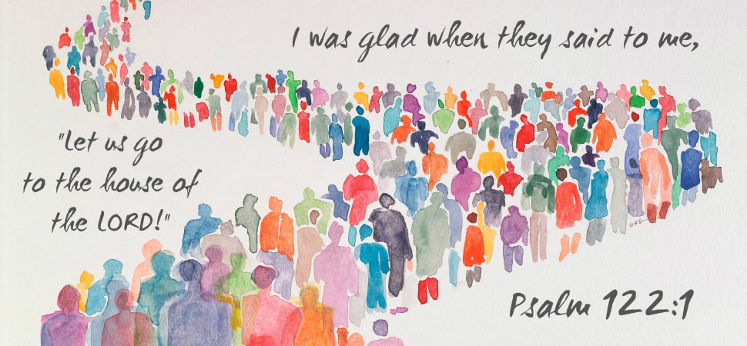
The Joy of Worshiping God Together

Slide 2
The Joy of Worshiping God Together
Because He reigns over the earth with awesome power, supreme authority
& kingly majesty (Psalm 66:1-7; 99:1-5)
Because He is loving, kind, merciful, & forgiving towards his sinful creation/
shown in Christ (Exodus 34:6-8, Ps. 100:1-5; Ps. 103:8-14; Rom. 5:6-11)
He delights when we obey Him in spirit and truth, not by rote or tradition
(John 4:23-24; Isaiah 29:13; Matthew 15:7-9)

Slide 3
The Joy of Worshiping God Together
We commune in remembering His death on the 1st day of the week
(1 Corinthians 10:16-17; 11:23-34)
Blessing- We rejoice in singing praises with reverence to glorify His name
(Romans 15:9; Ephesians 5:19; Colossians 3:16-17; James 5:13)
Blessing- We encourage one another towards love & good deeds
(Hebrews 3:13; 10:23-25)
We eagerly receive the word & earnestly desire to practice it each and
everyday of our lives! (Acts 10:33; 17:11; 2 Peter 1:10)

