Slide 1
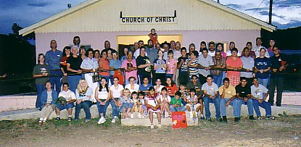
Spiritual Blessings of being a Member of the Church #5
Notes:
You obey gospel, baptized, God adds saved to the church, & decide to join a local church like Saul did in Acts 9 so that he can work, worship, & have fellowship with faithful brethren & several have decided to do that recently Many don’t want to place membership & be subject to divine directions but be a floating member. There are spiritual blessings & benefits being a member of a local church & as a result being a blessing to your spiritual family. Duty but do it with joy.

Slide 2
Blessings we receive from God, we bless others
Being subject to God- we subject ourselves to each other
Love & unity from God- we’re diligent to preserve unity
Emancipated- encourage each other love & good works
Strength in weakness- strengthen each other in the faith
Strong foundation- support & build one another up
Intercessor- we intercede on behalf of our brethren
Necessities of life- we take care of each other’s needs
Guidance- we grow together spiritually as a body
Security from Spiritual Harm- sow the seed to save souls

Slide 3
Spiritual Blessings of being a Member of the Church #5
Blessings from God (Ephesians 1:3-14) | Be a Blessing to Your Brethren (1 Peter 3:8-12)
Security from spiritual harm & a home in heaven (Proverbs 1:7, 20, 33; Proverbs 2:8ff; John 1:27-30; 1 Peter 1:3-9; Revelation 22:14) | Sow the seed, God will give the increase (1 Corinthians 3:5-9; Matthew 13:18-23, 36-43; John 4:34-38; Psalm 126:1-6; Galatians 6:7-9)

