Slide 1
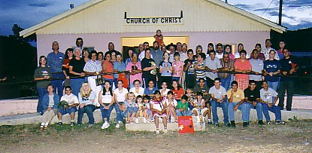
Spiritual Blessings of being a Member of the Church
Notes:
You obey gospel, baptized, God adds saved to the church, & decide to join a local church like Saul did in Acts 9 so that he can work, worship, & have fellowship with faithful brethren & several have decided to do that recently Many don’t want to place membership & be subject to divine directions but be a floating member. There are spiritual blessings & benefits being a member of a local church & as a result being a blessing to your spiritual family. Duty but do it with joy.

Slide 2
Spiritual Blessings of being a Member of the Church
Blessings from God (Ephesians 1:3-14) | Be a Blessing to Your Brethren (1 Peter 3:8-13)
Being in subjection under God’s perfect arrangement for life (Ephesians 1:18-23; Matthew 28:18-20; 1 Cor. 14:33, 40; 15:20-28) | Be subject to one another in reverence for Christ (Ephesians 5:21-6:9; 1 Peter 2:13-3:8; Hebrews 13:7, 17)

Slide 3
Spiritual Blessings of being a Member of the Church
Blessings from God (Ephesians 1:3-14) | Be a Blessing to Your Brethren (1 Peter 3:8-12)
Perfect love & unity shown in the Father’s plan & Son’s sacrifice so that believers might be united in truth (John 17:17-24; Rom. 5:8; Eph. 2:4-5, 14-16; 5:1-2; 1 Cor. 1:10; 4:17) | Love one another being diligent to preserve unity (John 13:34-35; 1 Cor. 13) 1 Peter 1:22-25; 4:8; Ephesians 1:15; 4:1-13; 1 Thessalonians 4:9-10; 1 John 3:16-18; 4:19-21)

Slide 4
We can be united as a congregation, love one another, & stand for the truth in Jesus Christ through God’s word.
As you have received all the spiritual blessings in Christ, you be a blessing to your brethren by being in subjection under God’s divine arrangement in every area of our lives.
The Father, Son, & Holy Spirit are united & we can also but we must be diligent to preserve it as the truth is taught, brethren practice it, & love one another as God loved us.
If you haven’t obeyed the gospel by being baptized do it today so that you can enjoy all the spiritual blessings in Christ (Acts 2:38; 22:16; 2 Cor. 6:2).

