Slide 1
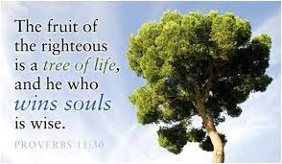
Those that Win Souls Must…

Slide 2
Those that Win Souls Must…
Be a Godly Example
(Matthew 5:13-16; 2 Corinthians 3:1-2)
Be Totally Committed
(Luke 9:56-62; Galatians 2:20; Romans 6:16-18)
Be Prepared to Teach
(2 Timothy 2:2, 15-26; 4:2-4)
Love the Lost & Take Joy in their Salvation
(John 3:16; Luke 15:7, 10-32; 19:9; Philippians 4:4)

Slide 3
Those that Win Souls Must…
Recognize the Value of every Soul
(Matthew 16:26; Hebrews 2:9)
Believe in the Gospel’s Power to Save & Unashamed of it
(Romans 1:16-17; 2 Timothy 1:12)
Pray (1 Thess. 5:17; 2 Thess. 3:1)
Persevere when Persecuted for the Cause of Christ
(1 Timothy 1:12-16; 4:16; 1 Peter 2:12; 3:14-16)

