Slide 1
Hymns for Worship at Woodmont
19 Heavenly Sunlight
68 Lord, We Come Before Thee Now
Opening Prayer
474 Grace Greater Than Our Sin
Lord’s Supper
125 Nearer, Still Nearer
Sermon- How Dust & Ashes are Used in the Bible
343 Let Him Have His Way with Thee
695 Savior, Grant Me Rest and Peace- Closing Prayer
Notes:
God spoke all things into existence but different with man- created from dust unique. “dust of the earth”. But we aren’t only just Dust in the Wind (song by Kansas in 1977) & breath of God- combination of earthly, natural material and life-giving power from God Himself-highlights importance & value of human life.- suggests lowliness. God didn’t use gold, granite, gemstones to make man. He used dust, a humble substance. We’re dependent on God for breath & the fragile nature of human life in a fallen world He did create—using natural material (dust) & His power to give humans a unique place in the cosmos. We are called to worship the Lord and to serve Him only.

Slide 2
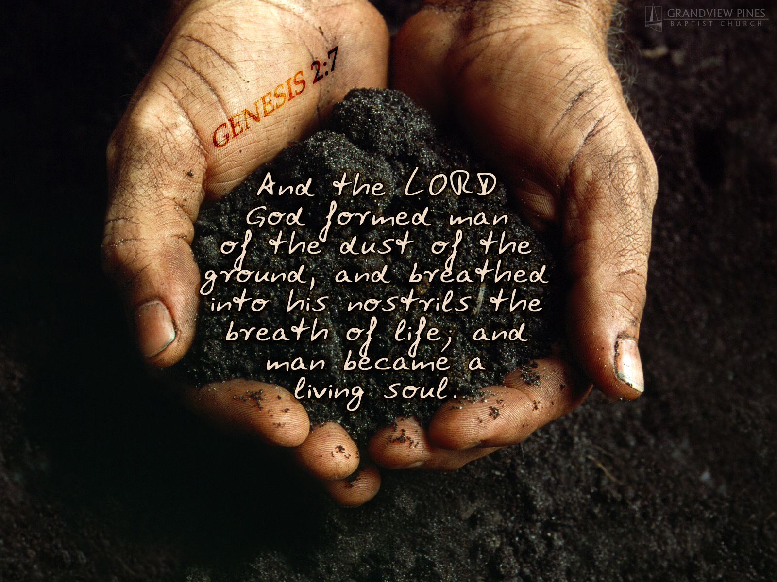
How
Dust
&
Ashes
are
Used
in the
Bible
Notes:
God spoke all things into existence but different with man- created from dust unique. “dust of the earth” & breath of God- combination of earthly, natural material and life-giving power from God Himself-highlights importance & value of human life.- suggests lowliness. God didn’t use gold, granite, gemstones to make man. He used dust, a humble substance. We’re dependent on God for breath & the fragile nature of human life in a fallen world He did create—using natural material (dust) & His power to give humans a unique place in the cosmos. We are called to worship the Lord and to serve Him only.

Slide 3
How Dust & Ashes are Used in the Bible | What God’s Word Teaches | What You Should Do before God

Slide 4
How Dust & Ashes are Used in the Bible | What God’s Word Teaches | What You Should Do before God
Material of Human Body (Genesis 2:7)

Slide 5
How Dust & Ashes are Used in the Bible | What God’s Word Teaches | What You Should Do before God
Material of Human Body (Genesis 2:7) | God breathed into man’s nostrils & he became a living being (Genesis 2:7)

Slide 6
How Dust & Ashes are Used in the Bible | What God’s Word Teaches | What You Should Do before God
Material of Human Body (Genesis 2:7) | God breathed into man’s nostrils & he became a living being (Genesis 2:7) | I will give thanks, praise God, & live by His word (Psalm 139:13-16; Matthew 4:4)

Slide 7
How Dust & Ashes are Used in the Bible | What God’s Word Teaches | What You Should Do before God
Mourning over sin & repenting of them (Daniel 9:1-3; Job 40:1-5; Job 42:1-7)

Slide 8
How Dust & Ashes are Used in the Bible | What God’s Word Teaches | What You Should Do before God
Mourning over sin & repenting of them (Daniel 9:1-3; Job 40:1-5; Job 42:1-7) | Man is guilty of sin & should humbly submit to God, whose kindness in Christ should lead you to repentance (Rom. 2:4; 3:23ff)

Slide 9
How Dust & Ashes are Used in the Bible | What God’s Word Teaches | What You Should Do before God
Mourning over sin & repenting of them (Daniel 9:1-3; Job 40:1-5; Job 42:1-7) | Man is guilty of sin & should humbly submit to God, whose kindness in Christ should lead you to repentance (Rom. 2:4; 3:23ff) | I will have godly sorrow leading me to repent of my sins & be baptized (2 Cor. 7:10; Acts 2:38; 3:19; Luke 15:7)

Slide 10
How Dust & Ashes are Used in the Bible | What God’s Word Teaches | What You Should Do before God
Times of dark despair (Esther 4:1-3; 2 Samuel 13:19; Job 2:7-8)

Slide 11
How Dust & Ashes are Used in the Bible | What God’s Word Teaches | What You Should Do before God
Times of dark despair (Esther 4:1-3; 2 Samuel 13:19; Job 2:7-8) | God hears the prayer of the righteous- His grace is enough for you to endure (Psalm 34:15-19; 2 Cor. 12:7-9)

Slide 12
How Dust & Ashes are Used in the Bible | What God’s Word Teaches | What You Should Do before God
Times of dark despair (Esther 4:1-3; 2 Samuel 13:19; Job 2:7-8) | God hears the prayer of the righteous- His grace is enough for you to endure (Psalm 34:15-19; 2 Cor. 12:7-9) | I will pray to God through Christ- He will provide grace & mercy to help me in my time of need (Heb. 4:14-16)

Slide 13
How Dust & Ashes are Used in the Bible | What God’s Word Teaches | What You Should Do before God
Job’s friends wept when they saw his wretched appearance (Job 2:11-12)

Slide 14
How Dust & Ashes are Used in the Bible | What God’s Word Teaches | What You Should Do before God
Job’s friends wept when they saw his wretched appearance (Job 2:11-12) | The friends sat with him for seven days to comfort & sympathize with him (Job 2:13)

Slide 15
How Dust & Ashes are Used in the Bible | What God’s Word Teaches | What You Should Do before God
Job’s friends wept when they saw his wretched appearance (Job 2:11-12) | The friends sat with him for seven days to comfort & sympathize with him (Job 2:13) | I will sympathize, weep, & comfort those who are suffering (Romans 12:15; 1 Cor. 12:26)

Slide 16
How Dust & Ashes are Used in the Bible | What God’s Word Teaches | What You Should Do before God
Abram pleads with God for 10 souls to be spared in Sodom & Gomorrah (Genesis 18:27ff)

Slide 17
How Dust & Ashes are Used in the Bible | What God’s Word Teaches | What You Should Do before God
Abram pleads with God for 10 souls to be spared in Sodom & Gomorrah (Genesis 18:27ff) | It was destroyed as a sign for those who live ungodly lives later (Genesis 19:24; 2 Peter 2:6; Jude 1:7)

Slide 18
How Dust & Ashes are Used in the Bible | What God’s Word Teaches | What You Should Do before God
Abram pleads with God for 10 souls to be spared in Sodom & Gomorrah (Genesis 18:27ff) | It was destroyed as a sign for those who live ungodly lives later (Genesis 19:24; 2 Peter 2:6; Jude 1:7) | Plead with God for souls to be saved and try to teach them (Romans 10:1; Colossians 4:2-6)

Slide 19
How Dust & Ashes are Used in the Bible | What God’s Word Teaches | What You Should Do before God
Man will die and return to dust, his spirit back to God (Genesis 3:19; Ecclesiastes 3:20; Ecclesiastes 12:7)

Slide 20
How Dust & Ashes are Used in the Bible | What God’s Word Teaches | What You Should Do before God
Man will die and return to dust, his spirit back to God (Genesis 3:19; Ecclesiastes 3:20; Ecclesiastes 12:7) | After death, you’ll be judged by your deeds in the body (Hebrews 9:27; 2 Cor. 5:10)

Slide 21
How Dust & Ashes are Used in the Bible | What God’s Word Teaches | What You Should Do before God
Man will die and return to dust, his spirit back to God (Genesis 3:19; Ecclesiastes 3:20; Ecclesiastes 12:7) | After death, you’ll be judged by your deeds in the body (Hebrews 9:27; 2 Cor. 5:10) | Examine yourself by the Scriptures, be alert, ready, and prepared for the Lord’s return (2 Cor. 13:5; Matt. 24:42-45)

Slide 22
How Dust & Ashes are Used in the Bible | What God’s Word Teaches | What You Should Do before God
Whether you are cremated or buried you will be resurrected from the dead (John 5:28-29; 1 Cor. 15:42-57)

Slide 23
How Dust & Ashes are Used in the Bible | What God’s Word Teaches | What You Should Do before God
Whether you are cremated or buried you will be resurrected from the dead (John 5:28-29; 1 Cor. 15:42-57) | You will either be rewarded with eternal life in heaven or condemned to hell (Matt. 25:46)

Slide 24
How Dust & Ashes are Used in the Bible | What God’s Word Teaches | What You Should Do before God
Whether you are cremated or buried you will be resurrected from the dead (John 5:28-29; 1 Cor. 15:42-57) | You will either be rewarded with eternal life in heaven or condemned to hell (Matt. 25:46) | Today is the day of salvation- obey the gospel by repenting and being baptized or be restored (Ax 2:38; 8:20-24)

Slide 25
Realizing I am but dust & ashes & a sinner I will…
…praise God for how He made me in His image
…mourn over my sins- repent & be baptized to be forgiven
…pray to God when I’m suffering knowing He will help me
…weep with those who weep & comfort those who suffer
…plead with God for opportunities to save lost souls
…examine myself by the Scriptures & be ready for His return
…obey the gospel or be restored if I’m still in my sins
…look forward to being resurrected to praise God forever

Slide 26
Hymns for Worship at Woodmont
19 Heavenly Sunlight
68 Lord, We Come Before Thee Now
Opening Prayer
474 Grace Greater Than Our Sin
Lord’s Supper
125 Nearer, Still Nearer
Sermon- How Dust & Ashes are Used in the Bible
343 Let Him Have His Way with Thee
695 Savior, Grant Me Rest and Peace- Closing Prayer
Notes:
God spoke all things into existence but different with man- created from dust unique. “dust of the earth”. But we aren’t only just Dust in the Wind (song by Kansas in 1977) & breath of God- combination of earthly, natural material and life-giving power from God Himself-highlights importance & value of human life.- suggests lowliness. God didn’t use gold, granite, gemstones to make man. He used dust, a humble substance. We’re dependent on God for breath & the fragile nature of human life in a fallen world He did create—using natural material (dust) & His power to give humans a unique place in the cosmos. We are called to worship the Lord and to serve Him only.

