Slide 1
Hymns for Worship at Woodmont
570 As the Life of a Flower
117 Guide Me O Thou Great Jehovah
162 Night with Ebon Pinion
416 Do All in the Name of the Lord
326 Trust and Obey
576 Faith is the Victory
Notes:
Children ask parents Passover tell them, God passed over Israe saw blood doorposts & killed Egyptians firstborn (Ex. 12:26). Our children ask bread & fruit of vine tell them God’s word. What about Christmas& birth of Christ? Shouldn’t we teach them. What did Jesus want His disciples to remember, birth, death, both ? God tells us what He wants us to do, by explaining it through His Son.

Slide 2
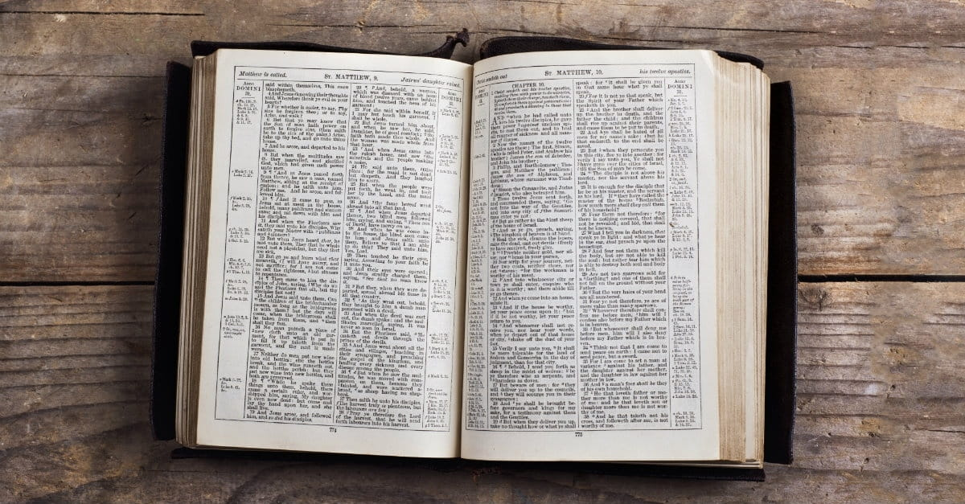
What did Jesus Command His Disciples to Remember: His Birth or His Death?
Notes:
Children ask parents Passover tell them, God passed over Israe saw blood doorposts & killed Egyptians firstborn (Ex. 12:26). Our children ask bread & fruit of vine tell them God’s word. What about Christmas& birth of Christ? Shouldn’t we teach them. What did Jesus want His disciples to remember, birth, death, both ? God tells us what He wants us to do, by explaining it through His Son.

Slide 3
Remember Jesus’ Death in the Lord’s Supper

Slide 4
Remember Jesus’ Death in the Lord’s Supper
Jesus said to His disciples in partaking of the unleavened bread before His death,

Slide 5
Remember Jesus’ Death in the Lord’s Supper
Jesus said to His disciples in partaking of the unleavened bread before His death, “This is my body which is given for you; do this in remembrance of Me” (Luke 22:19)

Slide 6
Remember Jesus’ Death in the Lord’s Supper | There is no evidence 12/25 is Jesus’ birthday
Jesus said to His disciples in partaking of the unleavened bread before His death, “This is my body which is given for you; do this in remembrance of Me” (Luke 22:19) | The Bible doesn’t reveal it.

Slide 7
Remember Jesus’ Death in the Lord’s Supper | There is no evidence 12/25 is Jesus’ birthday
Jesus said to His disciples in partaking of the unleavened bread before His death, “This is my body which is given for you; do this in remembrance of Me” (Luke 22:19) | The Bible doesn’t reveal it. “Concerning the date of Christ’s birth the Gospels give no help; upon their data contradictory arguments are based. The census would have been impossible in winter: a whole population could not then be put in motion” (Catholic Encyclopedia)
Notes:
Whatever is not revealed, God clearly doesn’t want us to know so as to observe but we are to obey what has been revealed (Deut. 29:29). Jesus is the Word as we studied on Wed night & became flesh, being born of a virgin in fulfillment of Isaiah 7:14; Matt. 1:22-23 but should we remember His birth?

Slide 8
Remember Jesus’ Death in the Lord’s Supper | There is no evidence 12/25 is Jesus’ birthday

Slide 9
Remember Jesus’ Death in the Lord’s Supper | There is no evidence 12/25 is Jesus’ birthday
This command was given to the church at Corinth.

Slide 10
Remember Jesus’ Death in the Lord’s Supper | There is no evidence 12/25 is Jesus’ birthday
This command was given to the church at Corinth. The apostle Paul said, “I received from the Lord that which I also delivered to you that the Lord Jesus…[took the bread & cup saying]… “do this in remembrance of Me” (1 Corinthians 11:23-25).

Slide 11
Remember Jesus’ Death in the Lord’s Supper | There is no evidence 12/25 is Jesus’ birthday
This command was given to the church at Corinth. The apostle Paul said, “I received from the Lord that which I also delivered to you that the Lord Jesus…[took the bread & cup saying]… “do this in remembrance of Me” (1 Corinthians 11:23-25). | There is no command given to the church to practice it.

Slide 12
Remember Jesus’ Death in the Lord’s Supper | There is no evidence 12/25 is Jesus’ birthday
This command was given to the church at Corinth. The apostle Paul said, “I received from the Lord that which I also delivered to you that the Lord Jesus…[took the bread & cup saying]… “do this in remembrance of Me” (1 Corinthians 11:23-25). | There is no command given to the church to practice it. Who gave it then?

Slide 13
Remember Jesus’ Death in the Lord’s Supper | There is no evidence 12/25 is Jesus’ birthday
This command was given to the church at Corinth. The apostle Paul said, “I received from the Lord that which I also delivered to you that the Lord Jesus…[took the bread & cup saying]… “do this in remembrance of Me” (1 Corinthians 11:23-25). | There is no command given to the church to practice it. Who gave it then? “The church in Rome began formally celebrating Christmas on December 25 in 336, during the reign of the emperor Constantine” (Encyclopedia Britannica)

Slide 14
Remember Jesus’ Death in the Lord’s Supper | There is no evidence 12/25 is Jesus’ birthday
Notes:
Jesus commanded it and the church at Corinth was told to observe it but were there any churches that actually practiced it?

Slide 15
Remember Jesus’ Death in the Lord’s Supper | There is no evidence 12/25 is Jesus’ birthday
The church at Jerusalem & Troas obeyed the command.
Notes:
Look at the examples of the church at Jerusalem and Troas.

Slide 16
Remember Jesus’ Death in the Lord’s Supper | There is no evidence 12/25 is Jesus’ birthday
The church at Jerusalem & Troas obeyed the command. “They were continually devoting themselves… to the breaking of bread” (Jerusalem- Acts 2:42)

Slide 17
Remember Jesus’ Death in the Lord’s Supper | There is no evidence 12/25 is Jesus’ birthday
The church at Jerusalem & Troas obeyed the command. “They were continually devoting themselves… to the breaking of bread” (Jerusalem- Acts 2:42) “On the 1st day of the week we gathered together to break bread” (Troas- Acts 20:7)

Slide 18
Remember Jesus’ Death in the Lord’s Supper | There is no evidence 12/25 is Jesus’ birthday
The church at Jerusalem & Troas obeyed the command. “They were continually devoting themselves… to the breaking of bread” (Jerusalem- Acts 2:42) “On the 1st day of the week we gathered together to break bread” (Troas- Acts 20:7) | There are no divinely approved examples of the 1st century church remembering His birth.

Slide 19
Remember Jesus’ Death in the Lord’s Supper | There is no evidence 12/25 is Jesus’ birthday
The church at Jerusalem & Troas obeyed the command. “They were continually devoting themselves… to the breaking of bread” (Jerusalem- Acts 2:42) “On the 1st day of the week we gathered together to break bread” (Troas- Acts 20:7) | There are no divinely approved examples of the 1st century church remembering His birth. According to historians when was it celebrated by churches?

Slide 20
Remember Jesus’ Death in the Lord’s Supper | There is no evidence 12/25 is Jesus’ birthday
The church at Jerusalem & Troas obeyed the command. “They were continually devoting themselves… to the breaking of bread” (Jerusalem- Acts 2:42) “On the 1st day of the week we gathered together to break bread” (Troas- Acts 20:7) | There are no divinely approved examples of the 1st century church remembering His birth. According to historians when was it celebrated by churches? By the end of the 4th century, the whole Christian world was celebrating Christmas on that day” (Collier Encyclopedia)

Slide 21
Remember Jesus’ Death in the Lord’s Supper | There is no evidence 12/25 is Jesus’ birthday

Slide 22
Remember Jesus’ Death in the Lord’s Supper | There is no evidence 12/25 is Jesus’ birthday
Since Paul taught the same thing in every church, the saints would have observed this command every first day of the week just like they gave on that day (1 Corinthians 4:17; 16:1-2)

Slide 23
Remember Jesus’ Death in the Lord’s Supper | There is no evidence 12/25 is Jesus’ birthday
Since Paul taught the same thing in every church, the saints would have observed this command every first day of the week just like they gave on that day (1 Corinthians 4:17; 16:1-2) | Since the Lord didn’t command it, the 1st century church didn’t observe it, the facts show that God’s word does not approve of remembering the birthday of Jesus in Christmas.

Slide 24
Remember Jesus’ Death in the Lord’s Supper | There is no evidence 12/25 is Jesus’ birthday
Since Paul taught the same thing in every church, the saints would have observed this command every first day of the week just like they gave on that day (1 Corinthians 4:17; 16:1-2) | Since the Lord didn’t command it, the 1st century church didn’t observe it, the facts show that God’s word does not approve of remembering the birthday of Jesus in Christmas. “The word Christmas…mass of Christ…first found in 1038” (Catholic Encyclopedia)

Slide 25
Remember Jesus’ Death in the Lord’s Supper | There is no evidence 12/25 is Jesus’ birthday
Notes:
How does God speak to us today? Is it through the Pope, Catholic church, denominations of men, whatever men preach, or the Scriptures?

Slide 26
Remember Jesus’ Death in the Lord’s Supper | There is no evidence 12/25 is Jesus’ birthday
God speaks to us today through His Son recorded in the Bible & since faith comes by hearing the word of Christ, a Christian can do it by faith, and contend earnestly for it. (Hebrews 1:1-2; Romans 10:17; Jude 1:3)

Slide 27
Remember Jesus’ Death in the Lord’s Supper | There is no evidence 12/25 is Jesus’ birthday
God speaks to us today through His Son recorded in the Bible & since faith comes by hearing the word of Christ, a Christian can do it by faith, and contend earnestly for it. (Hebrews 1:1-2; Romans 10:17; Jude 1:3) | Since it is impossible to please God without faith, how can you participate in an activity with a good conscience when there isn’t permission from the Lord to remember His birth in the man made celebration of Christmas? (Hebrews 11:6)

Slide 28
Remember Jesus’ Death in the Lord’s Supper | There is no evidence 12/25 is Jesus’ birthday

Slide 29
Remember Jesus’ Death in the Lord’s Supper | There is no evidence 12/25 is Jesus’ birthday
We are commanded to hold fast to the traditions we have been taught by God’s word & do all things in His name (2 Thessalonians 2:15; 2 Timothy 3:16-17; Colossians 3:17)

Slide 30
Remember Jesus’ Death in the Lord’s Supper | There is no evidence 12/25 is Jesus’ birthday
We are commanded to hold fast to the traditions we have been taught by God’s word & do all things in His name (2 Thessalonians 2:15; 2 Timothy 3:16-17; Colossians 3:17) | If we are holding fast to the traditions of men instead of obeying the Lord’s commands, we are giving lip service to God & our worship is in vain. (Matthew 15:3-9)

Slide 31
Remember Jesus’ Death in the Lord’s Supper | There is no evidence 12/25 is Jesus’ birthday
We are commanded to hold fast to the traditions we have been taught by God’s word & do all things in His name (2 Thessalonians 2:15; 2 Timothy 3:16-17; Colossians 3:17) | If we are holding fast to the traditions of men instead of obeying the Lord’s commands, we are giving lip service to God & our worship is in vain. (Matthew 15:3-9) Are you holding fast to the traditions of men or obeying the commands of God?

Slide 32
Remember Jesus’ Death in the Lord’s Supper | There is no evidence 12/25 is Jesus’ birthday

Slide 33
Remember Jesus’ Death in the Lord’s Supper | There is no evidence 12/25 is Jesus’ birthday
We remembered His death on the 1st day of the week today just like the other 51 weeks of the years in obedience to His command as Jesus spoke exactly as the Father told him and His words will judge us in the last day (Matt. 24:35; John 12:48-50; 1 Peter 4:11)

Slide 34
Remember Jesus’ Death in the Lord’s Supper | There is no evidence 12/25 is Jesus’ birthday
We remembered His death on the 1st day of the week today just like the other 51 weeks of the years in obedience to His command as Jesus spoke exactly as the Father told him and His words will judge us in the last day (Matt. 24:35; John 12:48-50; 1 Peter 4:11) | If you remember His birth on 12/25 but don’t obey His command to remember His death, how will you answer Him in the Judgment Day? (Matthew 7:21-23)

Slide 35
Remember Jesus’ Death in the Lord’s Supper | There is no evidence 12/25 is Jesus’ birthday
We remembered His death on the 1st day of the week today just like the other 51 weeks of the years in obedience to His command as Jesus spoke exactly as the Father told him and His words will judge us in the last day (Matt. 24:35; John 12:48-50; 1 Peter 4:11) | If you remember His birth on 12/25 but don’t obey His command to remember His death, how will you answer Him in the Judgment Day? (Matthew 7:21-23) Jesus said, “Why do you call me Lord, Lord, and do not do what I say” (Luke 6:46)?

Slide 36
Some Churches of Christ are Compromising
A church that has Christ as its head and calls itself
after His name will submit to do His will, preach the
word, and expose error instead of being like the world
(Ephesians 1:22-23; 5:11, 24; 2 Timothy 4:2-4).
If we aren’t teaching, warning, & encouraging our brethren
& children to contend earnestly for the truth, the next
generation might desire to join the multitude in celebration
of Christmas instead of remembering His death!

Slide 37
Altamesa Church of Christ December 14 at 11:30 AM ·
Our annual Christmas Musical is always a blessing to
watch and participate in! This year, our Children and
Teens reminded us that there is always Hope for Everyone.
Thank you to everyone who worked hard- and especially our children and teens for helping lead our worship service Sunday!
Where is the permission from Christ to put on a Christmas
musical in His name instead of preaching the word of God?
Who gets the glory for it, God or man?

Slide 38
Conclusion
The Lord commanded that we remember His death in the
Lord’s Supper, the 1st century church obeyed Him, and they
did it on the first day of the week.
There is no evidence that 12/25 is the birthday of Christ as
it wasn’t revealed in the Scriptures, you can’t do it by faith,
it isn’t in obedience to His command, your worship is
vain if you teach for doctrine a command of men, and
you will be judged by His word in the last day.
Notes:
It is confusing to children growing up even if they are raised in the church & hear lessons like this but parents let their children go to Christmas services and mass at midnight at the Catholic church like my parents did and it took me a long time, much suffering & a sinful life to realize and obey the truth and remember Jesus who died for me and to remember His death on the 1st day of every week. But seriously and soberly examine what you’re doing by the Scriptures for it will judge you in the last day.

Slide 39
Conclusion
This teaching will offend some, but we shouldn’t be
ashamed of the truth that He taught, bled, & died for
(Matthew 15:12; 1 Corinthians 15:3).
Our Heavenly Father didn’t put Christ in the celebration of
Christmas, and sadly it will be uprooted in the last day with
many being condemned (Matthew 7:13-14; 15:13-14).
It is not too late for you to repent and be baptized in order
to receive the forgiveness of your sins today
(Hebrews 5:8-9; Acts 2:38)!
Notes:
If you have any questions please feel free to ask. We’re desiring to speak the truth in love so that you might be saved and come to a knowledge of the truth of God who loves you, sent His Son to die on the cross for your sins, Jesus tasted death for you, and wanting you to be forgiven of all your sins but you have to believe He is the Son of God, repent of your sins & be baptized, bury that old person of sin and rise to walk in newness of life (New birth- be born again of water and the Spirit).

Slide 40
Hymns for Worship at Woodmont
570 As the Life of a Flower
117 Guide Me O Thou Great Jehovah
162 Night with Ebon Pinion
416 Do All in the Name of the Lord
326 Trust and Obey
576 Faith is the Victory

