Slide 1
Hymns for Worship at Woodmont
333 Jesus Will Give You Rest
Notes:
Rest: Don’t get enough! Long for, work to achieve, elusive. [Mk. 6:31 – God knew the value of rest.] Rest: “1) to cause or permit one to cease from any movement or labour in order to recover and collect his strength…3) to keep quiet, of calm and patient expectation” (Online Bible). Jesus offers rest that surpasses any sort of rest man can devise or provide.

Slide 2
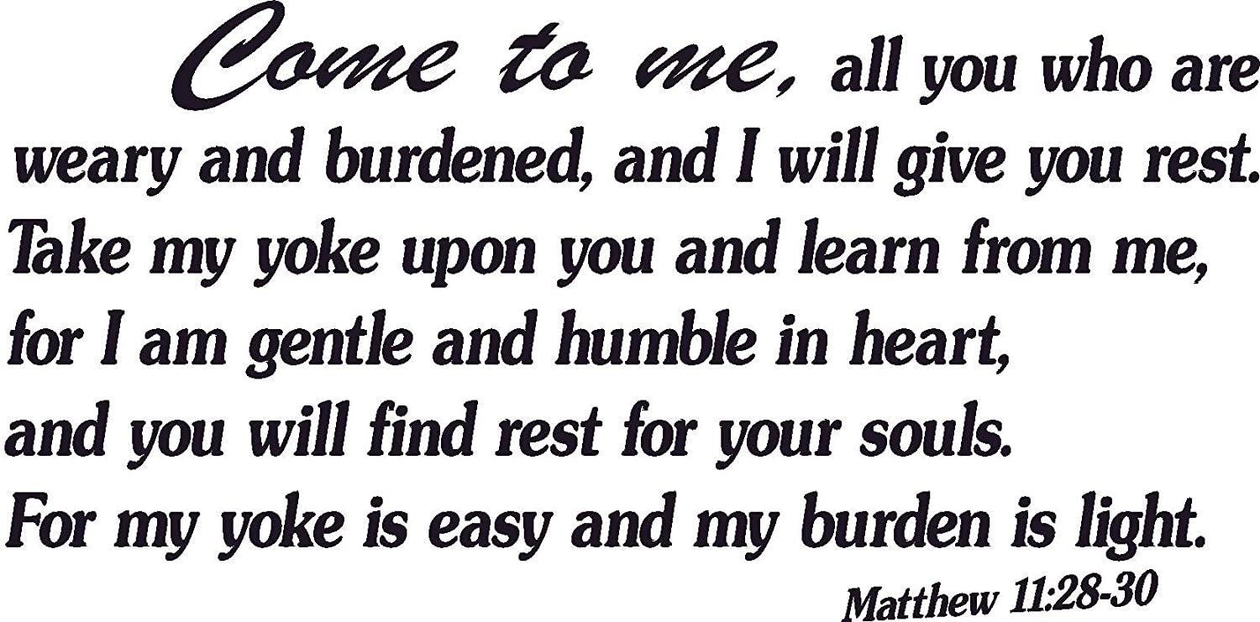
Jesus Will Give You Rest

Slide 3
Jesus Will Give You Rest (Mt. 11:28-30)
Jesus Gives You Rest from:

Slide 4
Jesus Will Give You Rest (Mt. 11:28-30)
Jesus Gives You Rest from:
The burden of sin (Psalm 38:1-8; 32:3-4; Proverbs 13:15)
Notes:
kopiáō (from 2873 /kópos, "exhausting labor") – to labor until worn-out, depleted (exhausted).
phortízō – overload (pack up), causing someone to be (literally) "weighted-down."

Slide 5
Jesus Will Give You Rest (Mt. 11:28-30)
Jesus Gives You Rest from: | You will Learn from Jesus:
The burden of sin (Psalm 38:1-8; 32:3-4; Proverbs 13:15)

Slide 6
Jesus Will Give You Rest (Mt. 11:28-30)
Jesus Gives You Rest from: | You will Learn from Jesus:
The burden of sin (Psalm 38:1-8; 32:3-4; Proverbs 13:15) | To find rest for your soul (Matthew 11:29; Jeremiah 6:16; Ephesians 4:22-24)
Notes:
anapaúō (from 303 /aná, "up, completing a process," which intensifies 3973 /paúō, "pause") – properly, to give (experience) rest after the needed task is completed; to pause (rest) "after precious toil and care" (Vine/Unger, White, NT).

Slide 7
Jesus Will Give You Rest (Mt. 11:28-30)
Jesus Gives You Rest from:
The world (John 16:33; 1 Corinthians 15:33; Luke 11:46)
Notes:
In the world you have tribulation but be of good courage, I have overcome the world. Yes bad company (false teachers) corrupts good morals. Others in the world will lay upon you heavy burdens because they aren’t doing their job (give you the right medicine, try to take advantage of you by charging you more than what you owe maybe hoping you won’t notice, you call them over & over to try to correct it but no one seems to care to do the right thing, and you get frustrated by the heavy burdens including persecution that they bring upon you because you want to do what’s right for you or your loved ones.

Slide 8
Jesus Will Give You Rest (Mt. 11:28-30)
Jesus Gives You Rest from: | You will Learn from Jesus:
The world (John 16:33; 1 Corinthians 15:33; Luke 11:46) | Refreshed by brethren (1 Corinthians 16:13-18; 2 Corinthians 7:10, 13; Philemon 1:7; Proverbs 13:20)
Notes:
What a blessing it is to be refreshed by your brethren who we are all following Christ as our head, we are the body, & they refresh our spirits in encouraging us toward love & good deeds instead of tempting us to sin or distract us from serving our Lord. This is where the Greek word for rest is used. Now that it is about 90 degrees we love to be refreshed by a cool cup of ice water & how satisfying that is. How much more to be refreshed when you’re going through a difficult time as Paul was in dealing with all the failures of the Corinthians brethren, being in prison, concerned for how Corinth would respond to God’s word. Walk with wise men & you will be wise but the companion of fools will suffer harm. Are you refreshed by your brethren realizing that Christ overcame the world or would you rather be quench your thirst with a wicked world which will destroy your soul.

Slide 9
Jesus Will Give You Rest (Mt. 11:28-30)
Jesus Gives You Rest from:
Worries (Luke 10:38-42)
Notes:
It is easy to get distracted & frustrated by all the worries & responsibilities that you have in this world and even if you’re wanting to do the right thing like Martha was in serving the Lord. One thing is important & her sister Mary chose the good part in listening to the Lord!

Slide 10
Jesus Will Give You Rest (Mt. 11:28-30)
Jesus Gives You Rest from: | You will Learn from Jesus:
Worries (Luke 10:38-42) | To have peace that passes all understanding as you pray, praise, & practice His will (Phil. 4:6-9; 1 Pet. 5:6-7)
Notes:
No matter what is going on in your life & you are all suffering with the temptations to worry about a lot of things, give it to God, give your worries to him, because He cares for you & all that you are doing in the Lord’s will. What a blessing it is to have the peace that passes all understanding! Do you have that in your life right now?

Slide 11
Jesus Will Give You Rest (Mt. 11:28-30)
Jesus Gives You Rest from:
Aimlessness (1 Corinthians 9:26-27; 1 Timothy 5:13)
Notes:
Many are living an idle, vain, empty life pursuing pleasures that will never satisfy. Doing wickedness is like sport to a fool & there are others who blindly follow in their footsteps into foolishness. The apostle Paul wasn’t aimless but instead lived a life filled with the purpose of serving God.

Slide 12
Jesus Will Give You Rest (Mt. 11:28-30)
Jesus Gives You Rest from: | You will Learn from Jesus:
Aimlessness (1 Corinthians 9:26-27; 1 Timothy 5:13) | To discipline your body and press on toward the goal of eternal life (Philippians 3:7-14)
Notes:
One thing I do: forget the past filled with pointless pursuits & focusing on the resurrection from the dead. Paul learned that from Jesus and you can too. But you have to want it with every fiber of your being to be like Christ who died for you, gave you hope, purpose, & joy with a future rest in heaven.

Slide 13
Jesus Will Give You Rest (Mt. 11:28-30)
Jesus Gives You Rest from:
Persecution (2 Thessalonians 1:6-10)
Notes:
Anesis- a loosening, relaxation, rest from persecutions. Yes the Thessalonian brethren were being persecuted and need to be reminded that those who didn’t know God & hadn’t obeyed the gospel (who were likely persecuting them) would be punished with everlasting destruction while they would be glorified in His saints on that day.

Slide 14
Jesus Will Give You Rest (Mt. 11:28-30)
Jesus Gives You Rest from: | You will Learn from Jesus:
Persecution (2 Thessalonians 1:6-10) | Eternal rest from your labors if you die in the Lord (Revelation 14:13)
Notes:
Those who die in the Lord will receive that eternal rest where there will be no more sorrow, suffering, temptations, trials, tribulations, death, pain, agony, persecutions, etc. God will wipe away every tear and there will be rest. What a blessing it is to rest physically and wake up to another day but how much more to wake up to the reality of enjoying eternal life in heaven! What a day of rejoicing that will be!

Slide 15
Have you Found Rest for Your Soul?
You won’t find it in fulfilling your fleshly desires which will
lead you to become a worry wart in a wasteful world!
Come learn of Jesus who humbled Himself by becoming
obedient to the point of death on the cross so that you can
be forgiven of your sins, have rest for your soul, be
refreshed by your brethren, have the peace that passes all
understanding, press on toward the goal of heaven, and if
you die in the Lord have eternal rest. You can do it!!

