Slide 1
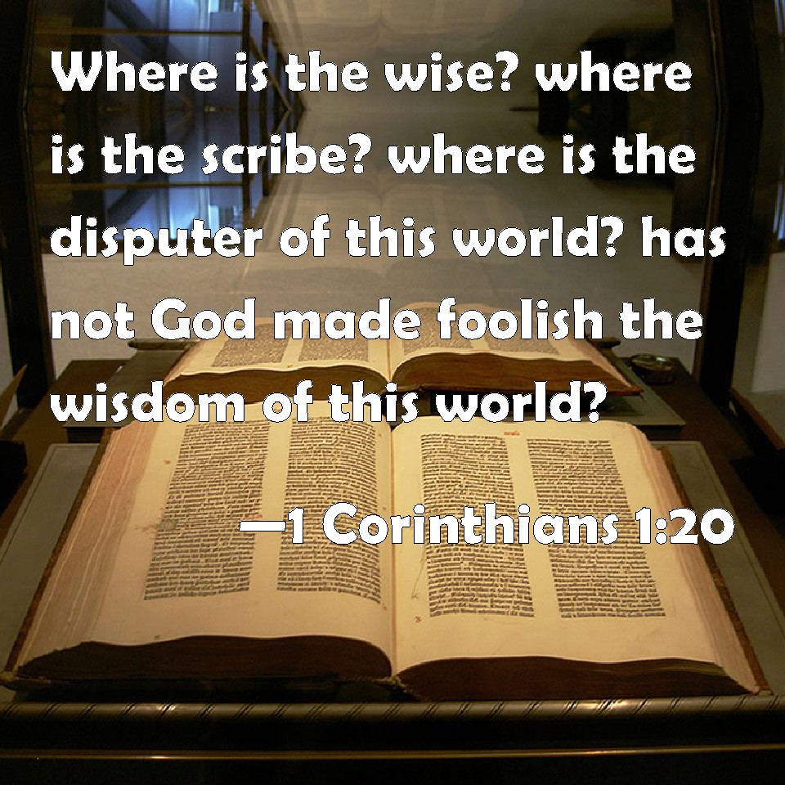
How Does
God Make
Foolish
the Wisdom
of the World
and Save
the Sinner?

Slide 2
“the word of the cross is folly to those who are perishing,
but to us who are being saved it is the power of God.
For it is written, “I will destroy the wisdom of the wise,
& the discernment of the discerning I will thwart.”
Where is the one who is wise? Where is the scribe?
Where is the debater of this age?
Has not God made foolish the wisdom of the world?
For since, in the wisdom of God, the world did not
know God through wisdom, it pleased God through
the folly of what we preach to save those who believe..

Slide 3
…For Jews demand signs & Greeks seek wisdom,
but we preach Christ crucified,
a stumbling block to Jews & folly to Gentiles,
but to those who are called, both Jews & Greeks,
Christ the power of God & the wisdom of God.
For the foolishness of God is wiser than men,
& the weakness of God is stronger than men.
For consider your calling, brothers:
not many of you were wise according to worldly standards,
not many were powerful, not many were of noble birth…

Slide 4
God chose what is foolish in the world to shame the wise;
God chose what is weak in the world to shame the strong;
God chose what is low & despised in the world,
Even things that are not,
to bring to nothing things that are, so that
no human being might boast in the presence of God.
And because of him you are in Christ Jesus,
who became to us wisdom from God,
righteousness and sanctification and redemption,
so that, as it is written,
“Let the one who boasts, boast in the Lord.”…

Slide 5
…when I came to you, brothers,
I did not come proclaiming to you the testimony of God
with lofty speech or wisdom.
For I decided to know nothing among you except
Jesus Christ & him crucified.
I was with you in weakness & in fear & much trembling,
& my speech & my message were not in plausible words
of wisdom, but in demonstration of the Spirit & of power,
so that your faith might not rest in the wisdom of men
but in the power of God…

Slide 6
…Yet among the mature we do impart wisdom,
although it is not a wisdom of this age or of the rulers
of this age, who are doomed to pass away.
But we impart a secret & hidden wisdom of God,
which God decreed before the ages for our glory.
None of the rulers of this age understood this, for if they
had, they would not have crucified the Lord of glory.
But, as it is written, “What no eye has seen,
nor ear heard, nor the heart of man imagined,
what God has prepared for those who love him…

Slide 7
…these things God has revealed to us through the Spirit.
For the Spirit searches everything, even the depths of God.
For who knows a person's thoughts except the spirit of
that person, which is in him? So also no one comprehends
the thoughts of God except the Spirit of God.
Now we have received not the spirit of the world,
but the Spirit who is from God, that we might understand
the things freely given us by God.
And we impart this in words not taught by human wisdom
but taught by the Spirit,
interpreting spiritual truths to those who are spiritual…

Slide 8
…The natural person does not accept
the things of the Spirit of God,
for they are folly to him,
& he is not able to understand them
because they are spiritually discerned.
The spiritual person judges all things,
but is himself to be judged by no one.
“For who has understood the mind of the Lord
so as to instruct him?”
But we have the mind of Christ”
(1 Corinthians 1:18-2:16)

Slide 9
How Does God Make Foolish the Wisdom of the World & Save the Sinner?
By Preaching Christ Crucified
to Save the Obedient Believer
(1 Corinthians 1:18-24; 2:1-16; Matthew 12:38-41;
Mark 16:16; Acts 2:36-47; 4:12; 2 Cor. 13:4)
Notes:
Paul preached Christ & Him crucified which was God’s power & wisdom contrasted with the worldly wise. God chose the foolishness of the message preached to save those who believe. (not by plays, dramas, jokes, dancing, music, entertainment, food, fun,two people talking about the Bible

Slide 10
How Does God Make Foolish the Wisdom of the World & Save the Sinner?
By Calling the Foolish, Weak & Despised
to Shame the Wise, Mighty & Noble
(1 Corinthians 1:25-29; 3:18-23; 4:8-13;
2 Corinthians 7:8-10; 10:10; 12:7-10; 13:4-10)
Notes:
Today Foolish- Days of Creation, Man & Woman, Monogamous Marriage Life, Purity, 1 Church, Hell, Paul epitome- Fools for Christ (1C4:10), weak appearance, despised speech (2C10:10), When weak or strengthless, strong (2 C 12:10), world- Saints foolish-God uses them to disgrace wise guys. Thorn in flesh, prays, weak are strong. Christians weaklings, Bible crutch, world appears strong (numbers, loud, boastful) but foolish before God. Paul’s speech despised (2 C 10:10) but he spoke God’s powerful word. Noble rulers of this age are nullified/passing away (1 C 2:6)

Slide 11
How Does God Make Foolish the Wisdom of the World & Save the Sinner?
By God’s Powerful Word,
the Sinner has been Redeemed, Sanctified,
& are Righteous in Christ Jesus
(1 Corinthians 1:24, 29-31; 6:9-11; 12:13)
Notes:
Sinner redeemed from being in bondage to sin, sanctified, holy, or set apart to be used in the Lord’s service, & right in the sight of God, God’s judicial approval, you have his approval,

Slide 12
The Natural Person Considers it Foolish to be Baptized for the Forgiveness of Sins
But 3,000 spiritually minded Jews were convicted that they had crucified the Son of God gladly received the word and were baptized (Acts 2:38).
Will you gladly receive the words of Jesus and obey Him in baptism so that you might be saved and be faithful until death or will you follow the world’s wisdom and remain in your sins?
Notes:
Sinner redeemed from being in bondage to sin, sanctified, holy, or set apart to be used in the Lord’s service, & right in the sight of God, God’s judicial approval, you have his approval,

