Slide 1
Hymns for Worship at Woodmont
16 A Mighty Fortress
73 Sweet Hour of Prayer
164 The Depth of God’s Love
452 He Keeps Me Singing
Sermon- Why is Singing So Important?
268 Hark the Gentle Voice
482 Just a Closer Walk with Thee

Slide 2
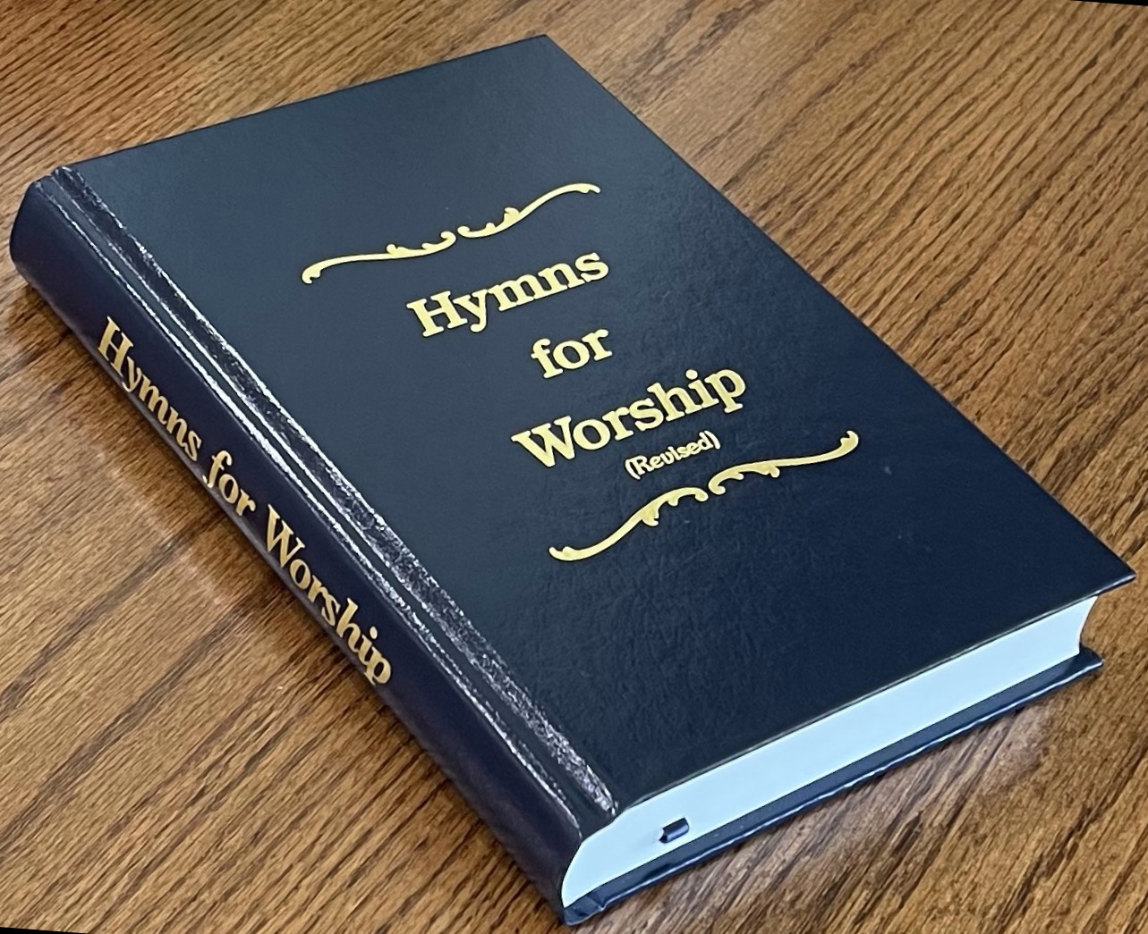
Notes:
Singing night Wednesday night. Why is it so important to sing? Sing to make us feel good, happy because it sounds good, I like the beat, melody, the way we sing it. You can’t sing online in virtual worship because there’s a lag. What a sad time it was when we weren’t in person early on during the Pandemic.

Slide 3
Why is Singing Hymns So Important?
You’re Obeying the Lord When You Do It
(Ephesians 5:18-19; John 4:23-24; 14:15; 15:9-10)
The Words Teach Scripture & Admonish One Another
(Deuteronomy 31:19ff; Colossians 3:16; Psalm 19:7-11)
You’re Honoring, Praising, & Glorifying God
(Psalm 100; 148; Hebrews 2:12; 13:15; Revelation 15:3-4)
Notes:
More about Jesus, Give Me the Bible, We’re Marching to Zion (let those refuse to sing who never knew our God) Trust and Obey, Blessed are They Who Do His Commandments, Hallelujah Praise Jehovah, He Keeps Me Singing, On Jordan’s Stormy Banks I Stand Holy Holy Holy

Slide 4
Why is Singing Hymns So Important?
You’re Giving Thanks to God & it Brings You Joy
(Jas. 5:13; Eph. 5:20; Col. 3:16; Phil. 4:4; 1 Thess. 5:18)
It Stirs You & Your Brethren Up to Love & Good Works
(Hebrews 10:23-24; Galatians 6:10; Ephesians 2:10)
It Helps You Persevere & Press on to the Goal of Heaven
(Acts 16:25ff; Philippians 3:13-14)
Notes:
Count Your Blessings, Give Thanks from Whom All Blessings Flow, Sing to Me of Heaven, Heavenly Sunlight, We Have an Anchor, Each Day I’ll Do, Just a Closer Walk with Thee, Higher Ground, Whispering Hope

