Slide 1
Hymns for Worship at Woodmont
607 Psalm 25
609 Psalm 148
652 There is a Green Hill
409 The Church’s One Foundation
Sermon- How Does the Bible Picture the Church
627 Like a Little Child
626 It is Well with My Soul
Notes:
Just as Jeroboam changed every aspect of how they were to worship God under the Old Covenant, many are changing the patter of the church in the NT.

Slide 2
How do you picture the church?
Notes:
Just as Jeroboam changed every aspect of how they were to worship God under the Old Covenant, many are changing the patter of the church in the NT.

Slide 3
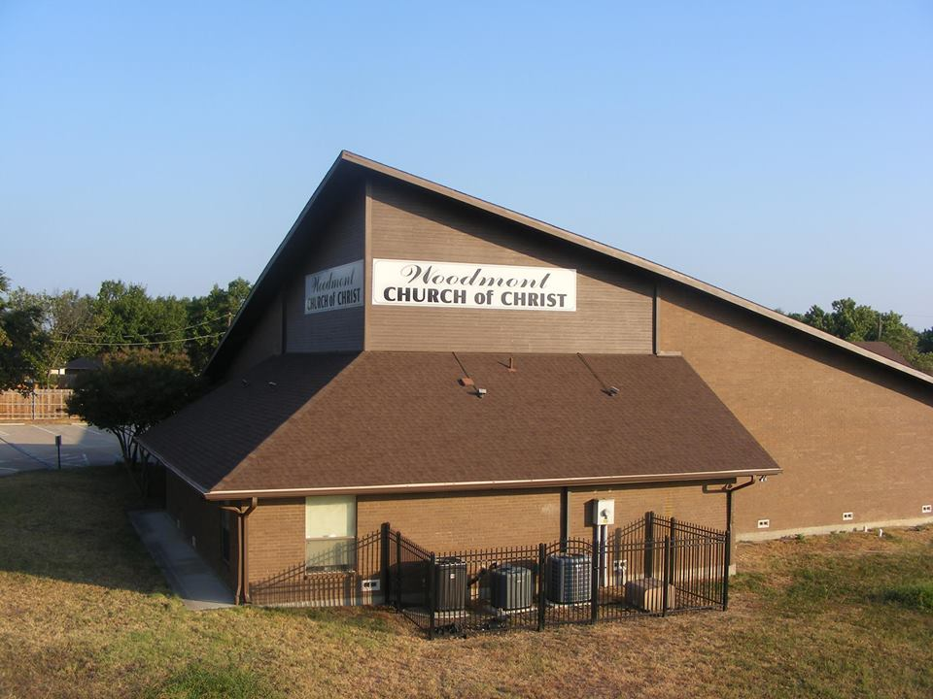
How do you picture the church?
Notes:
Just as Jeroboam changed every aspect of how they were to worship God under the Old Covenant, many are changing the patter of the church in the NT.

Slide 4
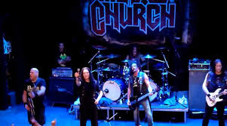
How do you picture the church?
Notes:
Just as Jeroboam changed every aspect of how they were to worship God under the Old Covenant, many are changing the patter of the church in the NT.

Slide 5
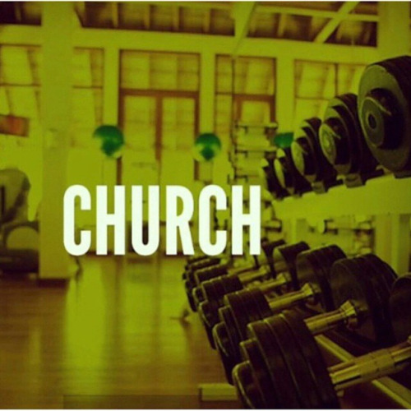
How do you picture the church?
Notes:
Just as Jeroboam changed every aspect of how they were to worship God under the Old Covenant, many are changing the patter of the church in the NT.

Slide 6
How do you picture the church?
Notes:
Just as Jeroboam changed every aspect of how they were to worship God under the Old Covenant, many are changing the patter of the church in the NT.

Slide 7
How Does the Bible Picture the Church?
“…The manifold wisdom of God
might now be made known through
the church
to the rulers & the authorities in the heavenly places.
This was in accordance with
the eternal purpose
which He carried out
in Christ Jesus our Lord”
(Ephesians 3:10-11)
Notes:
God’s word is infallible, inerrant, and inspired as furnishes us completely unto every good work God woul dhave us to do.

Slide 8
How Does the Bible Picture the Church?
“All Scripture is breathed out by God
and profitable
for teaching,
for reproof,
for correction,
& for training in righteousness,
that the man of God may be complete,
equipped for every good work” (2 Tim. 3:16-17)
Notes:
God’s word is infallible, inerrant, and inspired as furnishes us completely unto every good work God woul dhave us to do.

Slide 9
How Does the Bible Picture the Church?
“Be diligent to present yourself
approved to God as a workman
who does not need to be ashamed,
accurately handling the word of truth”
(2 Timothy 2:15)
“Examine everything carefully; hold fast to that
which is good; abstain from every form of evil”
(1 Thessalonians 5:21-22)
Notes:
God’s word is infallible, inerrant, and inspired as furnishes us completely unto every good work God woul dhave us to do.

Slide 10
The church of Christ
He promised to build it & did (Mt. 16:18; Acts 2:47)
He purchased it with His own blood (Acts 20:28)
She is His bride (Eph. 5:25, 31-32; Rev. 21:2)
He is head over all things to it (Eph. 1:22)
It is the body of Christ (Eph. 1:23)
He is the Savior of the body, the church (Eph. 5:23)

Slide 11
How “church” is Pictured in the NT
Universal [of Christ]- not the Roman Catholic church
There’s only one (Matt. 16:18; Eph. 1:22-23; 4:4)
It is the kingdom of Christ (Matt. 16:19; Eph. 2:19a)
It is the household of God (1 Tim. 3:15; Eph. 2:19b)
It is the temple of God (2 Cor. 6:16; Eph. 2:20-22)
Christ reigns in heaven as its head, not man on earth

Slide 12
How “church” is Pictured in the NT
Local- [churches of Christ- plurality] (Romans 16:16)
Local churches began when penitent believers were
baptized in response to the gospel being preached
(Matt. 28:18-20; Acts 1:8; 2:36-47; 18:8)
There were local churches established at Jerusalem,
Rome, Corinth, Galatia, Ephesus, Philippi, Thessalonica,
Sardis, Philadelphia, Smyrna, Pergamum, Thyatira, etc.

Slide 13
How “church” is Pictured in the NT
Each local church was to be organized under Christ with
elders, deacons, & saints (Ax 14:23; 1 Tim. 3; Phil. 1:1)
Each local church is to preach the gospel, edify
brethren, help needy saints, & discipline it’s members
(Eph. 4:11-16; Rom. 15:26; 2 Thess. 3:6-14)
Each local church was to worship God in spirit and truth
[pray, preach, sing acapella, give, partake Lord’s supper]
(John 4:24; Eph. 5:19, 1 Cor. 11:23-33; 14:15; 16:1-2)

Slide 14
The Local Church is not…
…the building (we don’t go to “church”- we are the
church who assemble to worship God- 1 Cor. 14:23)
…a business (sell property, books, food, raffle tickets
members give as they have prospered- 1 Cor. 16:2)
…a social center (parties, pot lucks, concert, recreation-
the church has a spiritual mission- Rom. 14:17)
…a sister congregation to other churches (the universal
church is made up of individual Christians, not churches)

Slide 15
Conclusion
Does your picture of the church match up with God’s?
Remember that the church belongs to Christ, not you!
God’s ways & thoughts are much higher than yours &
you will be judged by His word (Isa. 55:8-9; Jn. 12:48).
While you were still helpless, hopeless, & godless, Jesus
Christ died so that you could be forgiven of your sins
and not suffer eternal torment (Romans 5:6-11).

Slide 16
Conclusion
If you believe that Jesus is the Son of God (John 8:24),
repent of your sins (Luke 13:3),
confess Him before others (Matt. 10:32),
and are baptized (Mark 16:16),
the Lord has promised to forgive you of all of your sins
and add you to His church, not a denomination
(Acts 2:36-38, 47).

Slide 17
Hymns for Worship at Woodmont
607 Psalm 25
609 Psalm 148
652 There is a Green Hill
409 The Church’s One Foundation
Sermon- How Does the Bible Picture the Church
627 Like a Little Child
626 It is Well with My Soul
Notes:
Just as Jeroboam changed every aspect of how they were to worship God under the Old Covenant, many are changing the patter of the church in the NT.

