Slide 1
Hymns for Worship at Woodmont
4 Blessed Assurance
16 A Mighty Fortress
693 Were You There?
360 Standing on the Promises
296 How Firm a Foundation
390 Anywhere with Jesus
Notes:
We remember our fallen heroes who fought, bled & died for our country in the fight for our freedom tomorrow.

Slide 2
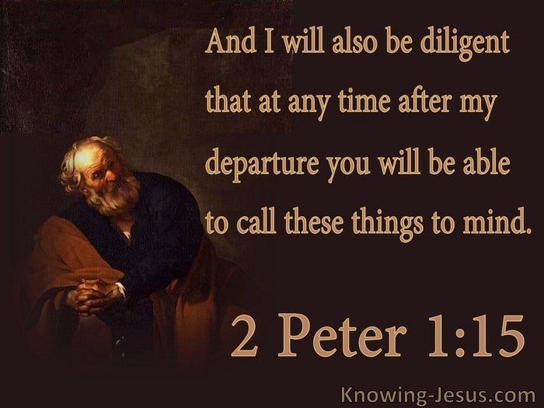
Urgent Reminders from Scripture
Notes:
We remember our fallen heroes who fought, bled & died for our country in the fight for our freedom tomorrow.

Slide 3
Urgent Reminders from Scripture
”Therefore, I will always be ready to remind you of these
things, even though you already know them, & have been
established in the truth which is present with you. I
consider it right, as long as I am in this earthly dwelling,
to stir you up by way of reminder, knowing that the laying
aside of my earthly dwelling is imminent, as also our Lord
Jesus Christ has made clear to me. And I will also be
diligent that at any time after my departure you will be
able to call these things to mind” (2 Peter 1:12-15)
Notes:
mnḗmē – remembrance, especially in a particular aspect ("a lasting memory"). This "memorial" (memory) deserves to be recollected, i.e. remembered to honor an important concept or teaching.

Slide 4
Remember…
…God keeps His promises so that you might be holy
(2 Peter 1:2-4; Ephesians 1:3-4)
…to be earnest & swift to practice the Christian graces
(2 Peter 1:5-11)
…the Lord’s words & commands spoken by the apostles
(2 Peter 1:16-21; 3:1-2; John 14:15, 26; 15:26-27; 16:13)
Notes:
spoudḗ ("speedy diligence") means quickly obeying what the Lord reveals is His priority. This elevates the better over the good – the more important over the important – and does so with earnest swiftness (intensity).

Slide 5
Remember…
…that God will only rescue the righteous from judgment,
not those who are deceived by the lies of false teachers
(2 Peter 2:1-22; Matthew 7:21-23)
…that God wants you to repent and not die in your sins
(2 Peter 3:1-9; Revelation 2:5; 3:3, 19-22)
…to be holy and godly in anticipation of eternal life, not
earthly things which will be burned up (2 Peter 3:10-18)
Notes:
3:12-14 Prosdokao- to expect (whether in thought, in hope, or in fear); to look for, wait for: one’s coming or return hágios) means "likeness of nature with the Lord" because "different from the world.“ Eusebia- someone's inner response to the things of God which shows itself in godly piety (reverence). Godly heart response

Slide 6
Are you…
…being holy in response to God’s promises?
…swift to practice righteousness or slothful?
…obeying the commands of the Lord or neglectful?
…holding fast to His words or deceived by lies?
…needing to repent & be baptized for salvation?
…anticipating the Lord’s return with joy or dread?

Slide 7
Hymns for Worship at Woodmont
4 Blessed Assurance
16 A Mighty Fortress
693 Were You There?
360 Standing on the Promises
296 How Firm a Foundation
390 Anywhere with Jesus
Notes:
We remember our fallen heroes who fought, bled & died for our country in the fight for our freedom tomorrow.

