Slide 1
Hymns for Worship at Woodmont
4 Blessed Assurance
118 Take Time to be Holy
160 One Day
190 We’re Marching to Zion
245 Where the Soul Never Dies
660 I will Sing the Mercies of the Lord

Slide 2
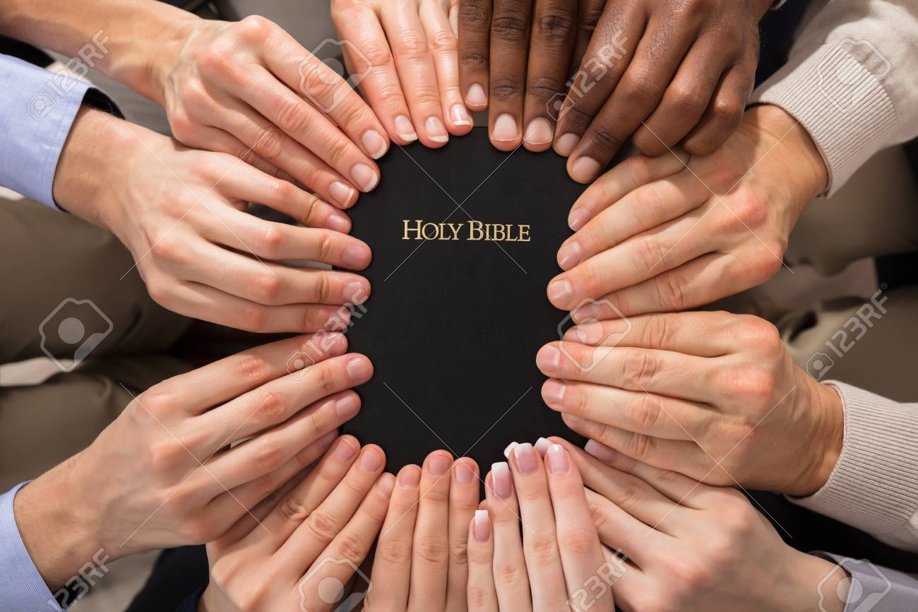
The Power of Unity in the Truth
Notes:
Most people don’t believe it’s possible that we can be united in the truth of God’s word. If they don’t agree with what the Bible says- that’s just your interpretation (people look at passages in different ways, get 20 people in a room with all different ideas). But it’s sad when brethren don’t believe it can be done as we studied with Luis Zamora in our gospel meeting in talking about Ed Harrell’s error. Is not God’s word correct, clear, understandable?

Slide 3
The Power of Unity in the Truth
We can be One as The Father, Son, & Holy Spirit are
(Gen. 1:1, 26; John 1:1; 17:17-23; Acts 10:38; 2 Cor. 13:14)
God’s Word was Confirmed by Signs
(Mk. 16:20; Jn. 16:13; 20:30-31; Heb. 1:1-4; 2:1-4; 4:12-13)
Spiritual Gifts Ceased when God’s Revelation was Complete
(1 Corinthians 13:8-10; James 1:25; 2 Timothy 3:14-17)
We Have the Exact Truth Written Down for Us to Live by
(Luke 1:1-4; Acts 1:1-4; Eph. 3:1-6; Col. 4:16; Matt. 4:4)
Notes:
Power of Unity in the universe since the beginning of time- thousands of years

Slide 4
The Power of Unity in the Truth
We are United with Christ in Baptism
(Romans 6:3-6; Acts 22:16; 1 Timothy 1:12-16)
In Scriptural Marriage, God Joins You to become One Flesh
(Gen. 2:24; Matt. 19:3-6; Mark 10:8; Eph. 5:31; Rom. 7:1-4)
In the Church of Christ, We are to be Diligent to Preserve It
(1 Cor. 1:10; Eph. 4:1-16; Phil. 1:27; Col. 3:14-15; Ps. 133:1)
In Christ, We are Equals with the Same Inheritance
(Galatians 3:26-29; 1 Corinthians 12:13)
Notes:
From heathen to holiness, sinner to saint, selfish to sacrificial, greedy to giver, social drinker to sober, promiscuous to purity, persecutor to preacher Sumphutos- planted together, joined together, of joint origin

Slide 5
Hymns for Worship at Woodmont
4 Blessed Assurance
118 Take Time to be Holy
160 One Day
190 We’re Marching to Zion
245 Where the Soul Never Dies
660 I will Sing the Mercies of the Lord

