Slide 1
Hymns for Worship at Woodmont
223 Peace Perfect Peace

Slide 2
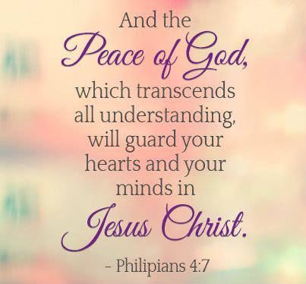
How to Have God’s Peace that Transcends our Thoughts

Slide 3
How to Have God’s Peace that Transcends our Thoughts (Philippians 4:4-9)
Rejoice everyday, no matter the circumstances
(Philippians 1:18; 2:17-18, 25-30; 3:1; 4:4)
Notes:
While some preachers were criticizing Paul while in prison because they were selfish, Paul rejoiced that Christ was preached. Even when facing death, he rejoiced with brethren.

Slide 4
How to Have God’s Peace that Transcends our Thoughts (Philippians 4:4-9)
Rejoice everyday, no matter the circumstances
(Philippians 1:18; 2:17-18, 25-30; 3:1; 4:4)
Be impartial and just with everyone
(James 3:17; 1 Timothy 3:3; Titus 3:2; John 7:24)
Notes:
epieikḗs ("justice beyond ordinary justice") builds on the real intent (purpose) of what is really at stake (note the epi, "upon") – hence, is true equity that appropriately fulfills the spirit (not just the letter) of the law. He knows that vengeance is Mine, says the Lord (Romans 12:19). It describes a person who is really free to let go of His anxieties and all the things that cause him stress, because he knows that the Lord will take up his cause.

Slide 5
How to Have God’s Peace that Transcends our Thoughts (Philippians 4:4-9)
Rejoice everyday, no matter the circumstances
(Philippians 1:18; 2:17-18, 25-30; 3:1; 4:4)
Be impartial and just with everyone
(James 3:17; 1 Timothy 3:3; Titus 3:2; John 7:24)
Don’t worry, pray with thanksgiving
(Luke 10:41; 12:22-32; Philippians 1:3-6)
Notes:
It’s hard to be thankful to God when your worried about many things that are going on in your life that you can’t control. But you can pray to the one who can help you have peace that God will answer your prayers so you can let it go and He can take care of it. Otherwise you are showing that you don’t really trust God. Martha demanded that the Lord tell her sister to help her but she needed to listen to the Lord like Mary was doing instead of being frustrated.

Slide 6
How to Have God’s Peace that Transcends our Thoughts (Philippians 4:4-9)
Meditate on Positive things
(2 Tim. 3:16-17; Ps. 1:2; Rom. 12:2; 2 Cor. 10:5)
Notes:
Look forward to meditating on God’s word everyday & it will bring you joy. You will be renewed in your mind realizing that it is good, acceptable, and perfect. You will be able to take every thought captive to the obedience of Christ. You can have the peace that passes all understanding that will guard your hearts & minds in Christ Jesus.

Slide 7
How to Have God’s Peace that Transcends our Thoughts (Philippians 4:4-9)
Meditate on Positive things
(2 Tim. 3:16-17; Ps. 1:2; Rom. 12:2; 2 Cor. 10:5)
Practice what you Preach from God’s Word
(1 Timothy 4:12-16; Matthew 7:1-5, 21-27; 23:1-5)
Notes:
Paul practiced what he preached, & Timothy was told to be an example of what he taught, believed, & practiced. Hypocritical judging is what is condemned, not judging with righteous judgment. Build your house on the rock, the solid rock of Christ, by doing what the Scripture says, not on the sinking stands of doubt, fear, and failure. The Pharisees were hypocrites, they not only didn’t practice what they preached but they bound heavy burdens on people & didn’t lift a finger to help them. You can have the peace that passes all understanding that will guard your hearts & minds in Christ Jesus.

Slide 8
Conclusion
Are you rejoicing everyday no matter what’s happening?
Are you impartial with everyone or play favorites?
Are you a ‘worry wart’ or always thankful in your prayers?
Are you meditating on positive or negative things?
Are you practicing what you preach or a hypocrite?
Notes:
Ephesians 2:14ff Jesus is our peace, won’t have peace in world (job, classmates, neighbors, etc.) conflicts with family, friends, acquaintances but have God’s peace transcending & guarding our thoughts in Christ. Phroureo- to guard (keep watch) like a military sentinel; (figuratively) to actively display whatever defensive and offensive means are necessary to guard. (See Prov. 6:20-23).

